Slide 1
Batch PSD Processing Report
Generated: 2026-02-11 14:39:14
February 11, 2026

Slide 2
Processing Configuration
Ground Rules & Assumptions
- PSD method: maximax with hann window
- Overlap: 50.0% and df 5.0 Hz
- Frequency spacing displayed as constant_bandwidth
- Running mean removal: Off
- Filtering: Baseline only (HP 1.0 Hz, LP 0.45xFs)
Source Data
- Source type: HDF5
- Source files: sample_flight_data.hdf5
- Channels processed: 11
- Events: Full duration + 3 event(s)
Processing Parameters
- Frequency range: 20.0 to 2000.0 Hz
- Efficient FFT: On
- Spectrograms: Enabled
- Statistics: Enabled

Slide 3
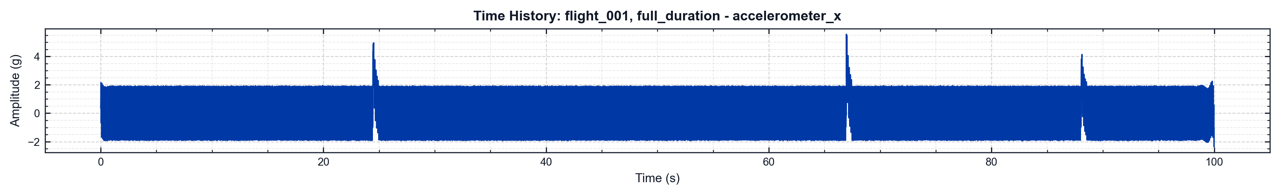
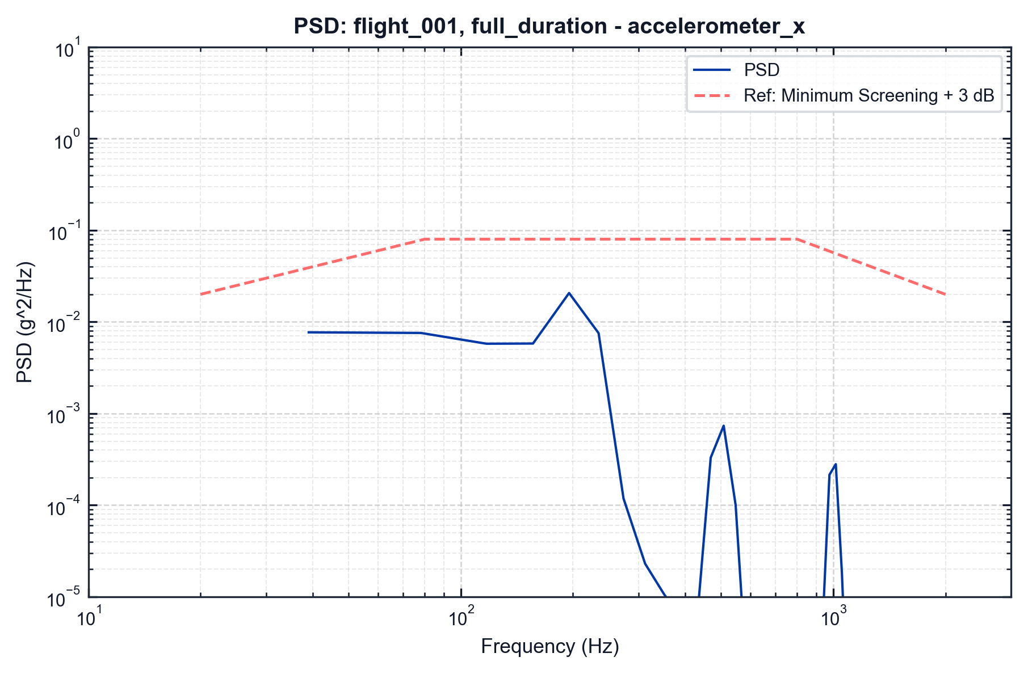
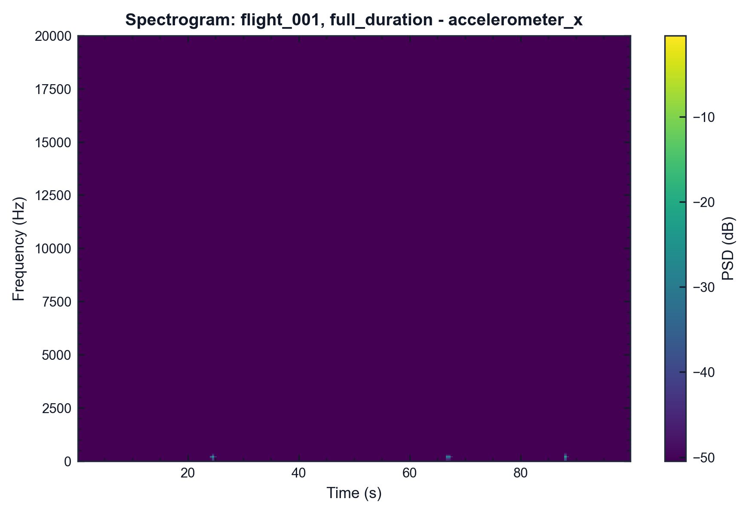
pyMARVIN v0.1.0 (Epic 1)
flight_001 | full_duration | accelerometer_x
df=5.0 Hz | spacing=constant_bandwidth | Fs=40000.0 Hz Event=full_duration (full duration) | Filter=None Method=Maximax | window=hann | overlap=50.0%
df=2.0 Hz | overlap=50.0% | SNR=50.0 dB Event=full_duration (full duration) | Fs=40000.0 Hz Colormap=viridis

Slide 4
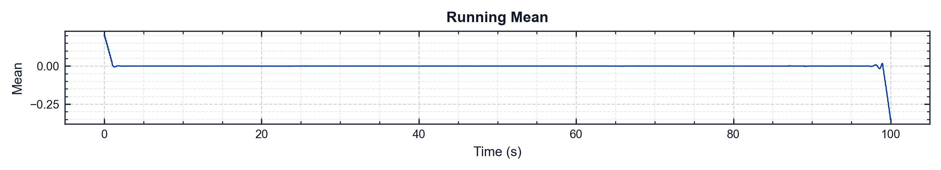
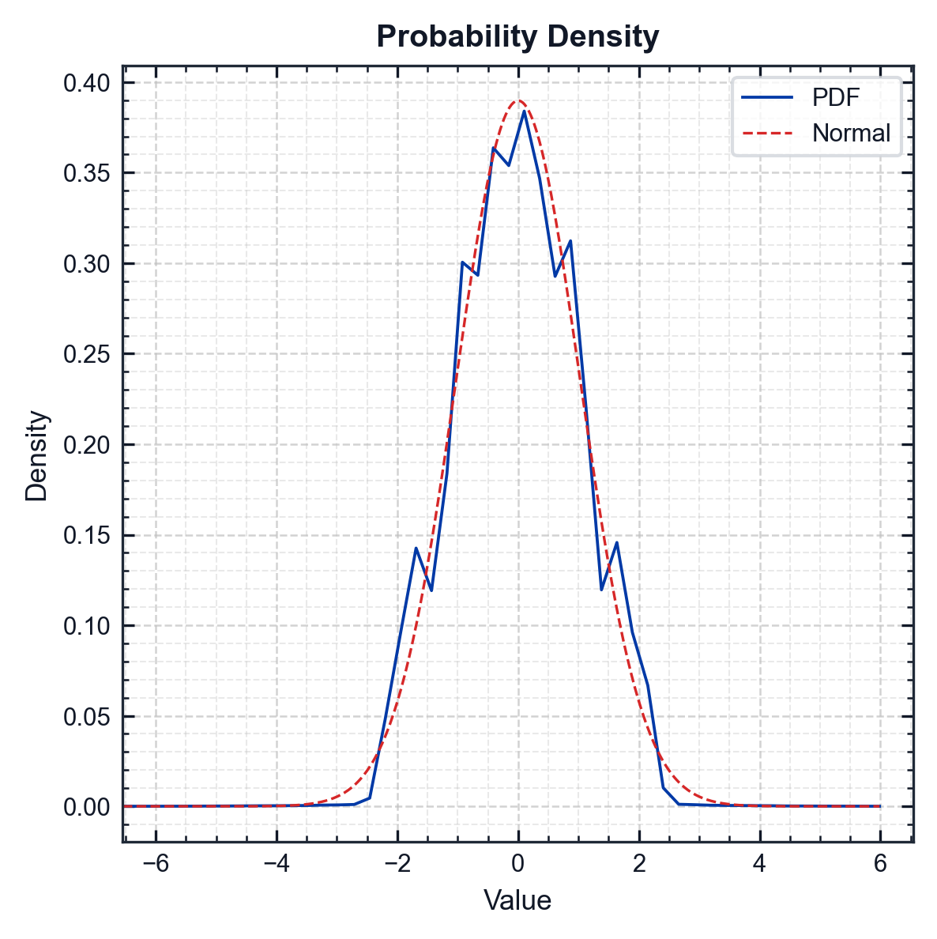
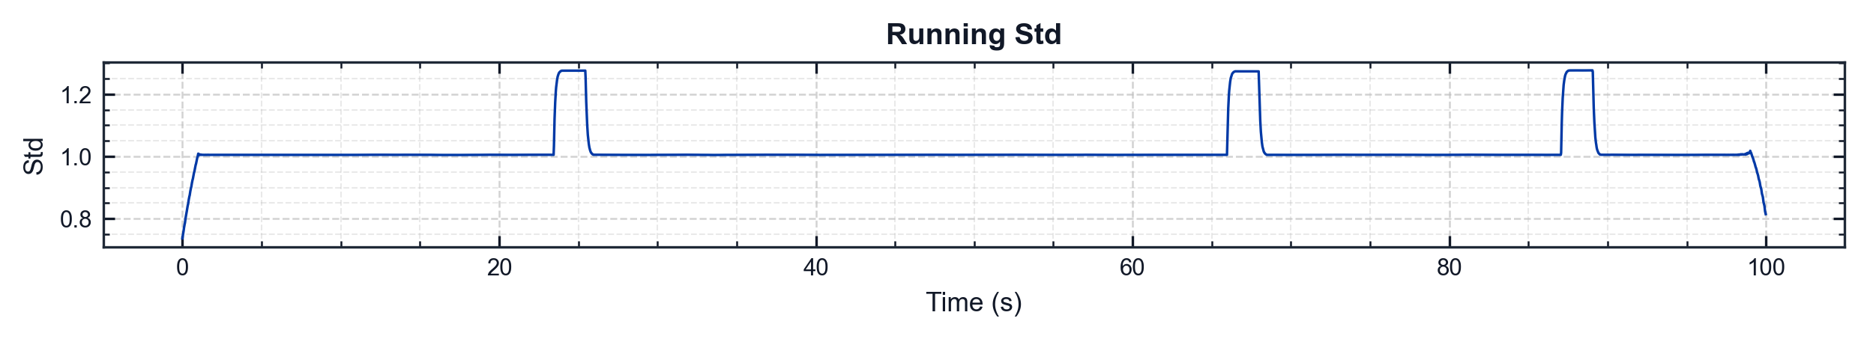
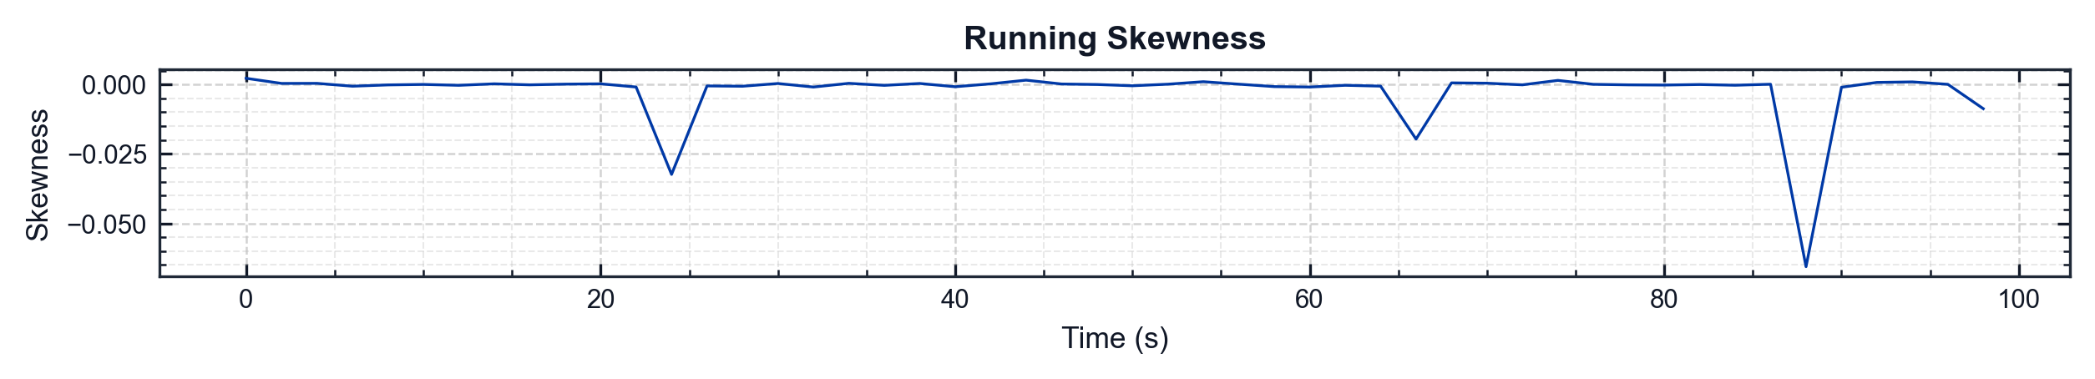
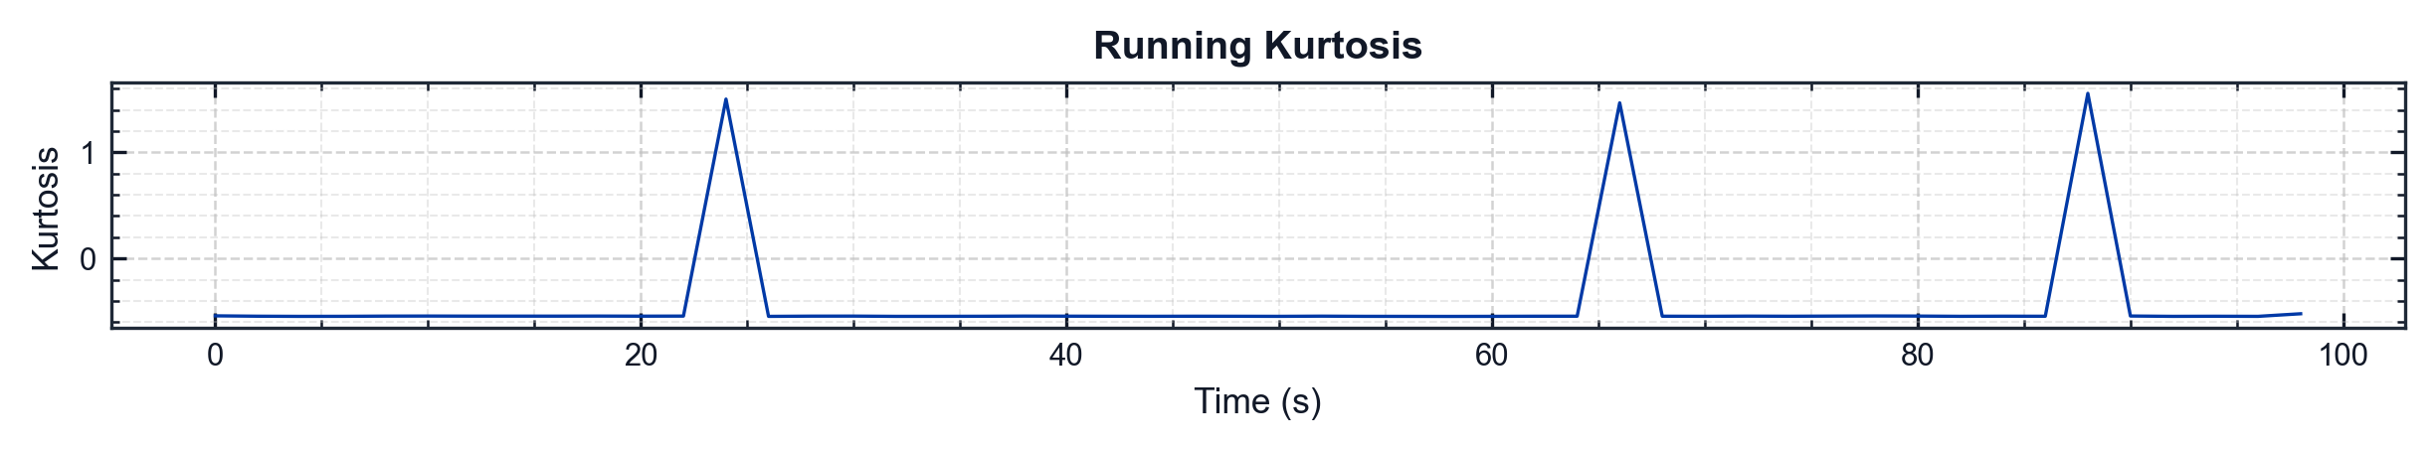
pyMARVIN v0.1.0 (Epic 1)
flight_001 | full_duration | accelerometer_x
Metric | Value
Mean | 0.0004 g
Std | 1.0236 g
Skewness | -0.0018
Kurtosis | -0.2479
Min | -6.6773 g
Max | 6.1118 g
RMS | 1.0236 g
Crest Factor | 6.5235
Conditioning | Filter: baseline+user (HP 1 Hz, LP 2000 Hz) | Running Mean Not Removed

Slide 5
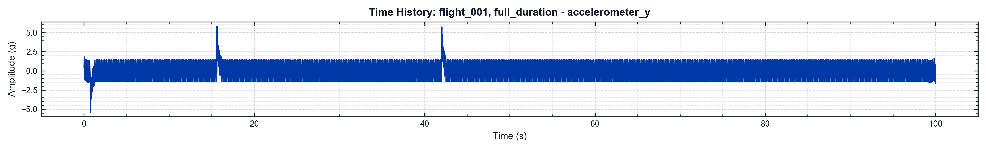
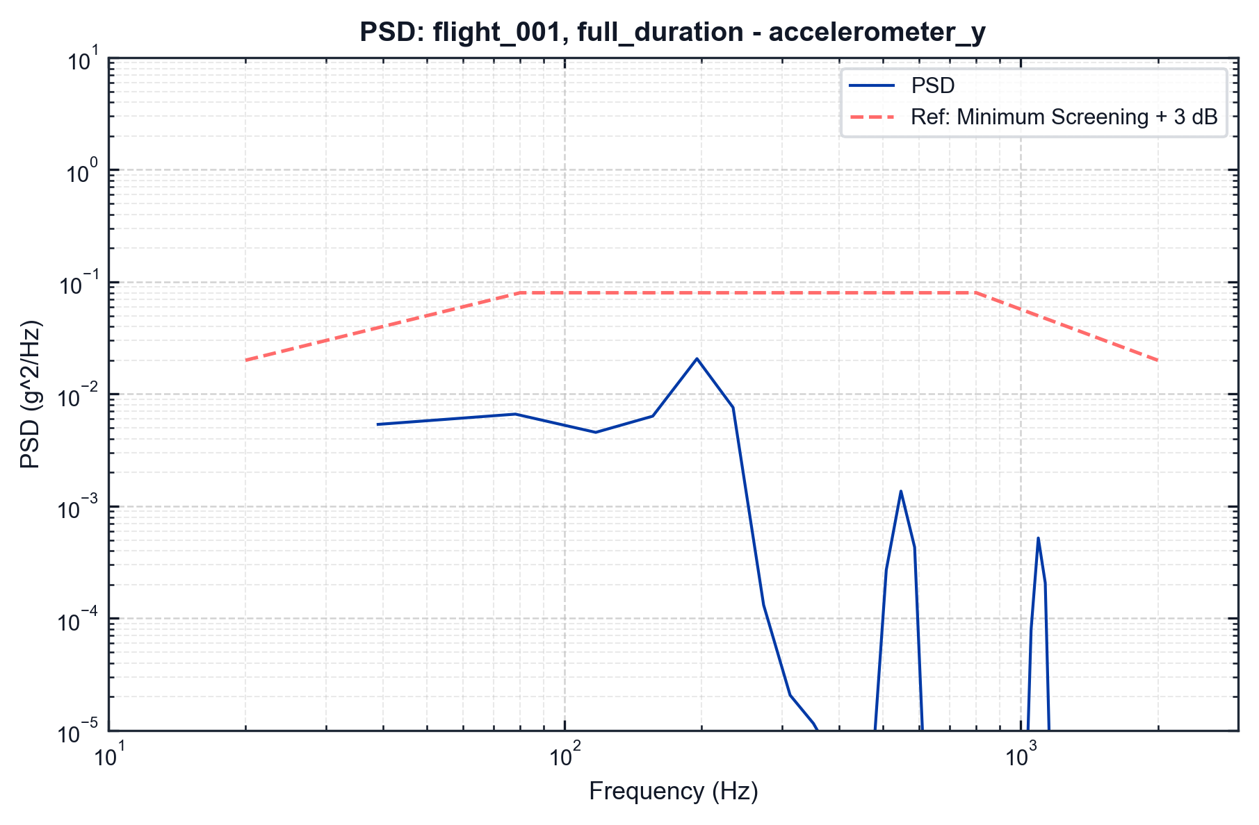
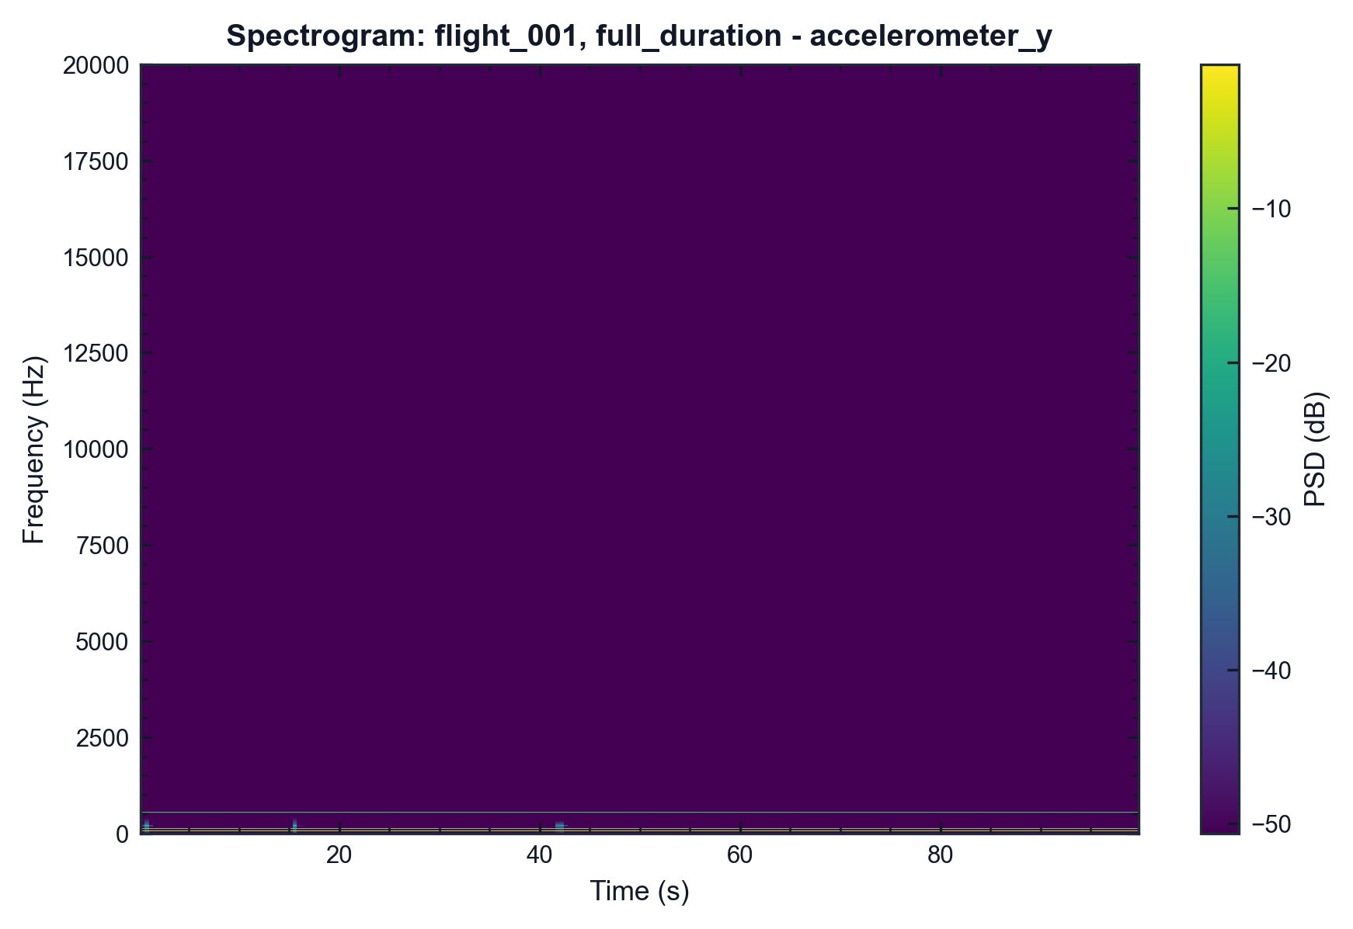
pyMARVIN v0.1.0 (Epic 1)
flight_001 | full_duration | accelerometer_y
df=5.0 Hz | spacing=constant_bandwidth | Fs=40000.0 Hz Event=full_duration (full duration) | Filter=None Method=Maximax | window=hann | overlap=50.0%
df=2.0 Hz | overlap=50.0% | SNR=50.0 dB Event=full_duration (full duration) | Fs=40000.0 Hz Colormap=viridis

Slide 6
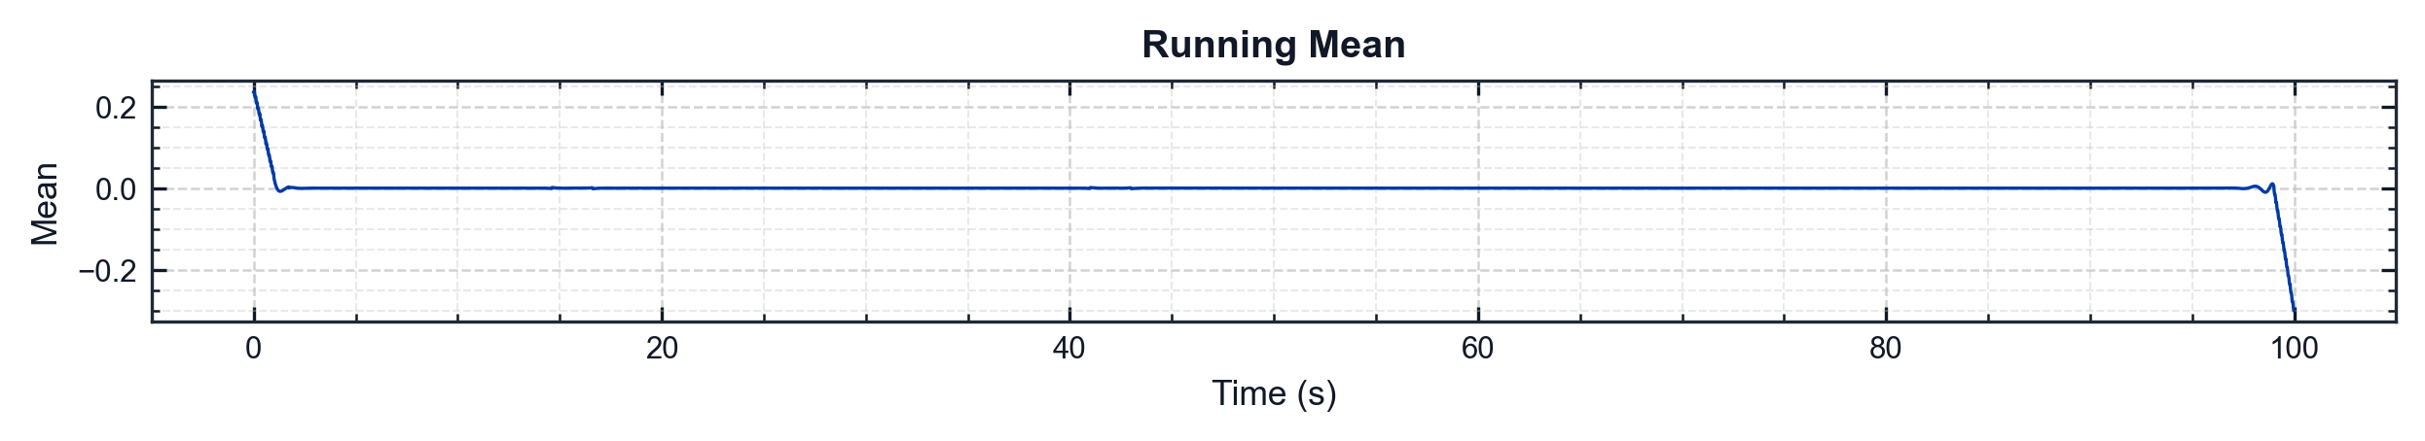
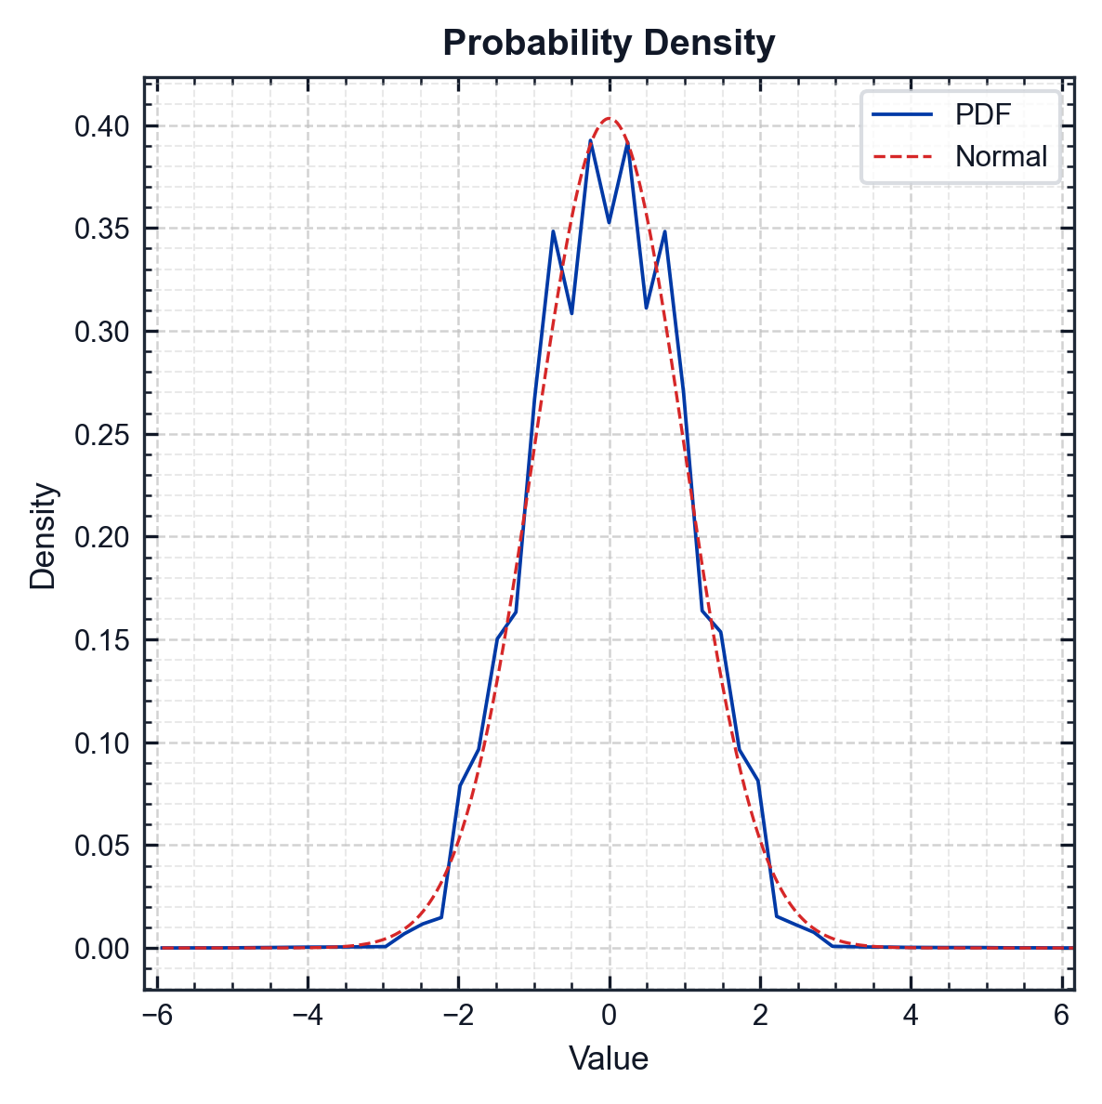
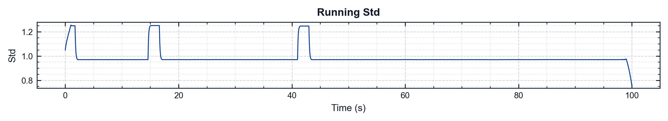
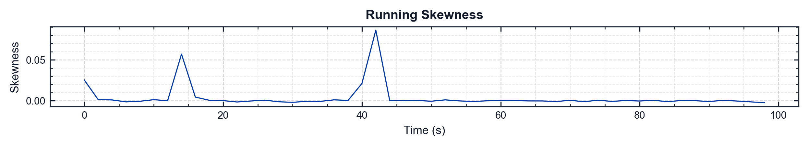
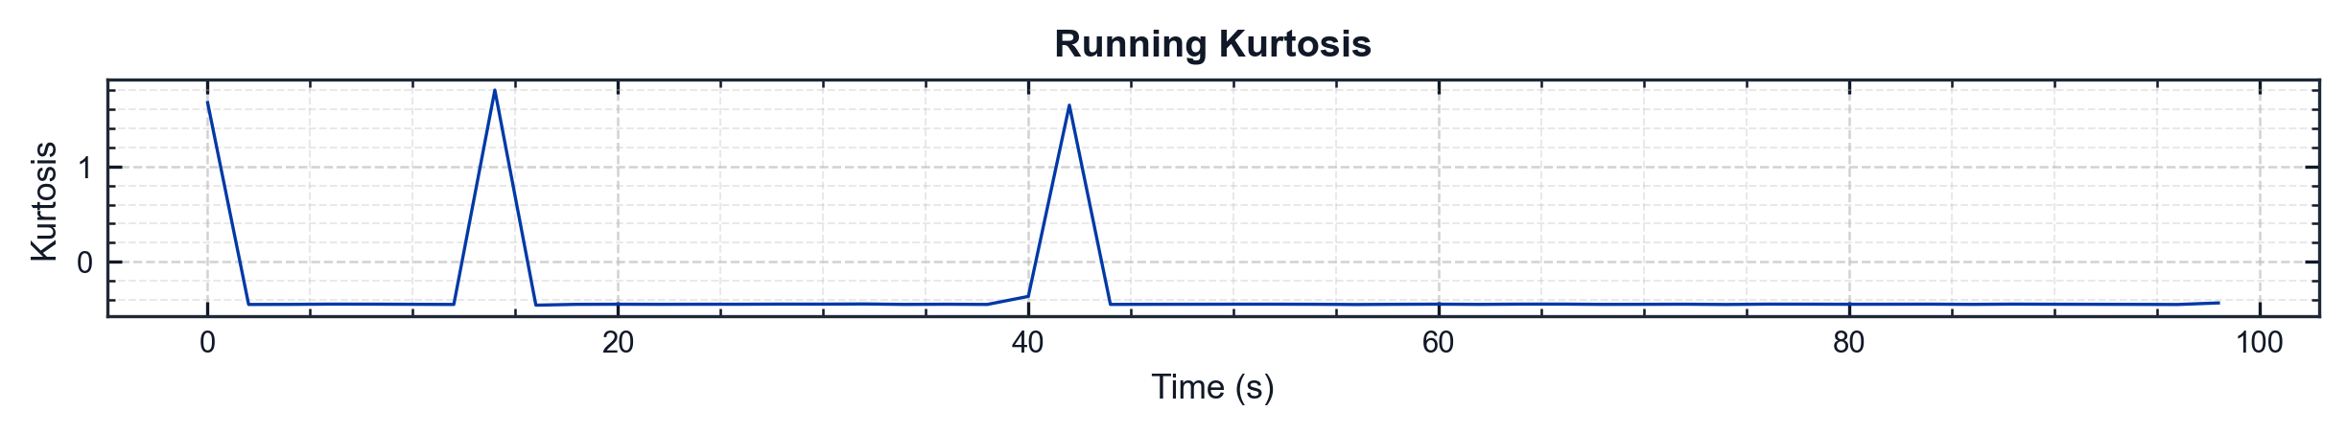
pyMARVIN v0.1.0 (Epic 1)
flight_001 | full_duration | accelerometer_y
Metric | Value
Mean | 0.0006 g
Std | 0.9892 g
Skewness | 0.0069
Kurtosis | -0.0420
Min | -6.0538 g
Max | 6.2926 g
RMS | 0.9892 g
Crest Factor | 6.3611
Conditioning | Filter: baseline+user (HP 1 Hz, LP 2000 Hz) | Running Mean Not Removed

Slide 7
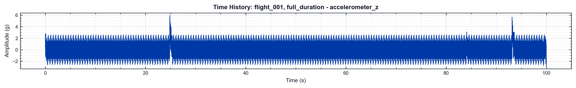
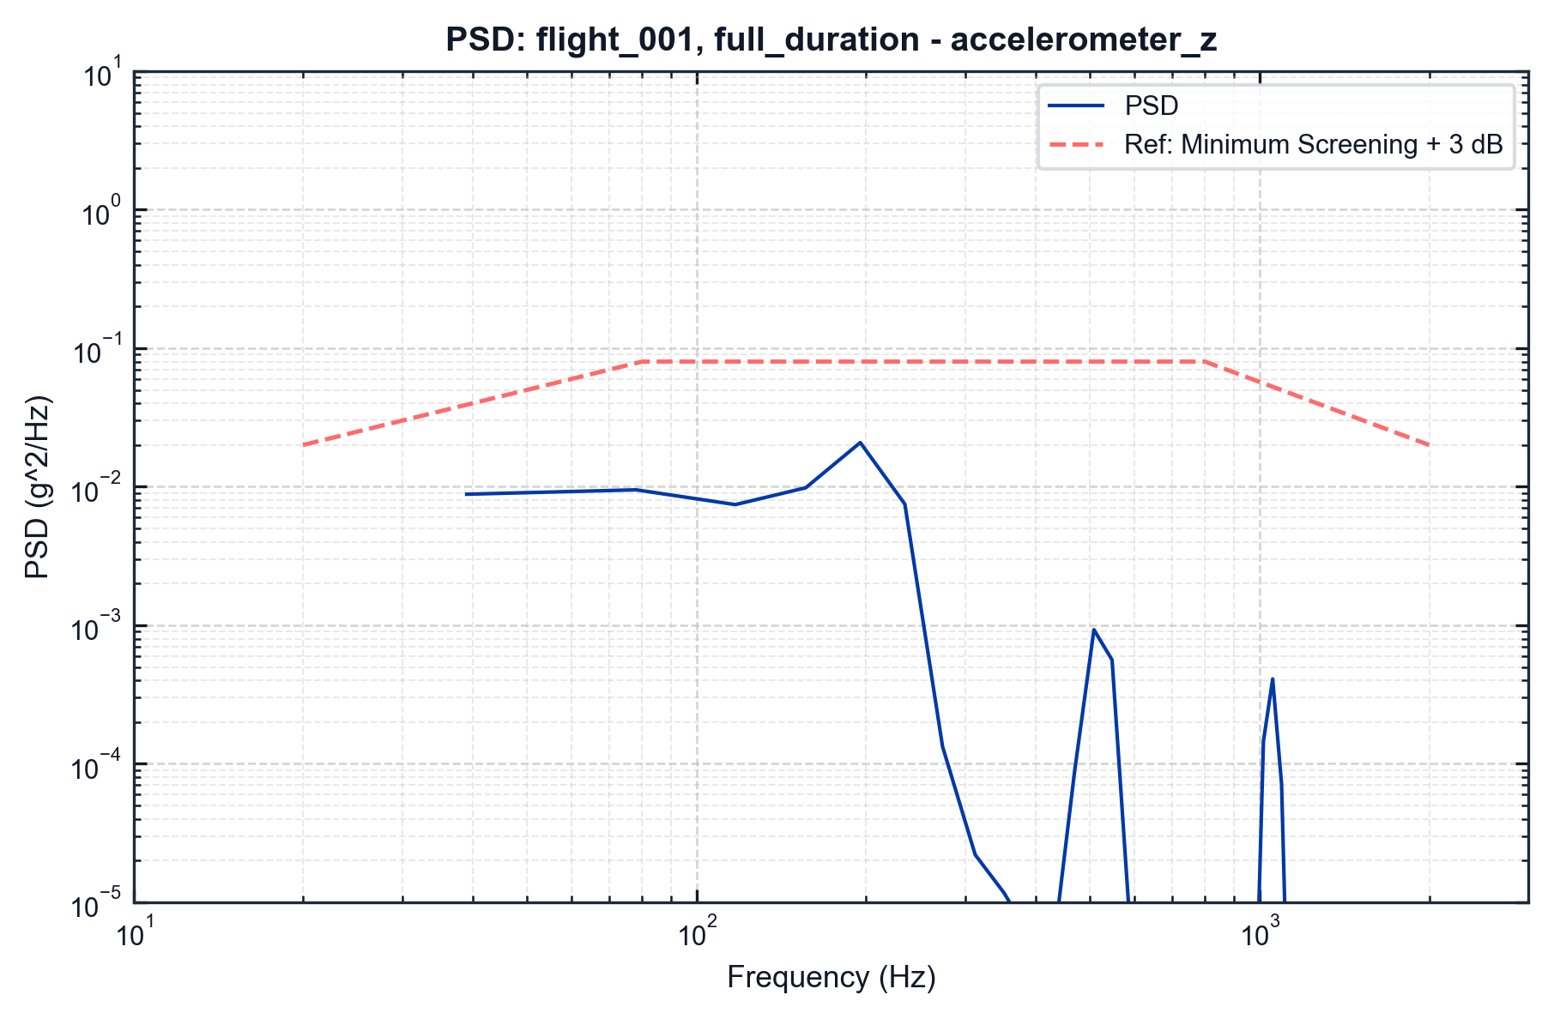

pyMARVIN v0.1.0 (Epic 1)
flight_001 | full_duration | accelerometer_z
df=5.0 Hz | spacing=constant_bandwidth | Fs=40000.0 Hz Event=full_duration (full duration) | Filter=None Method=Maximax | window=hann | overlap=50.0%
df=2.0 Hz | overlap=50.0% | SNR=50.0 dB Event=full_duration (full duration) | Fs=40000.0 Hz Colormap=viridis

Slide 8
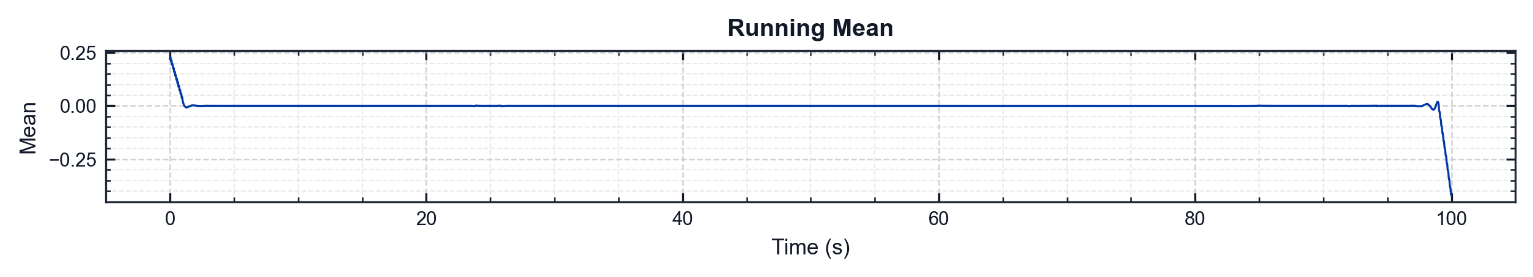
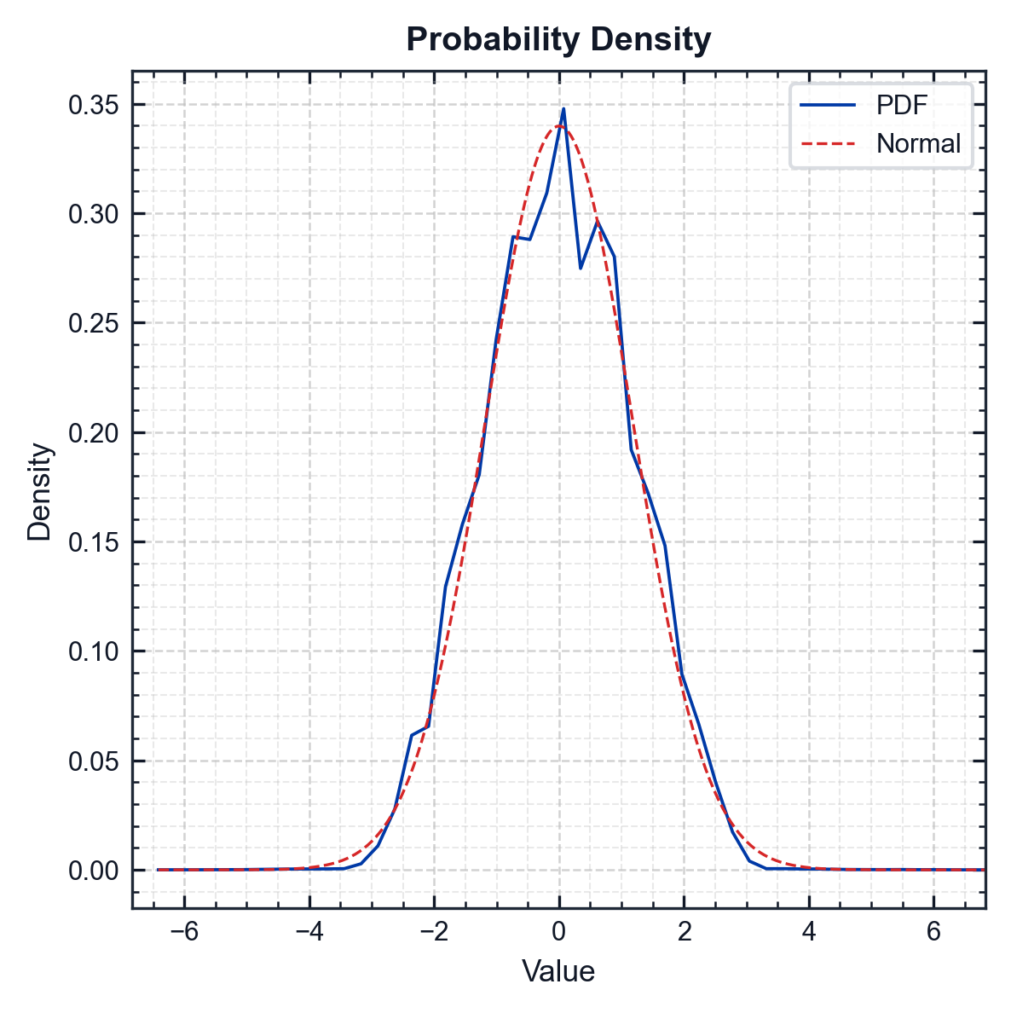
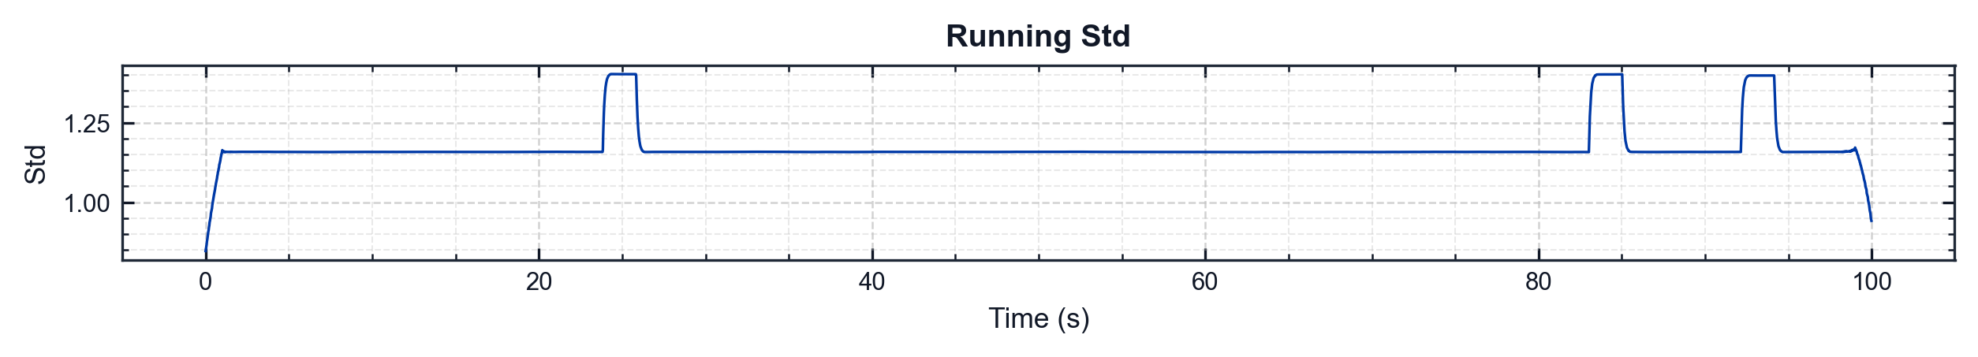
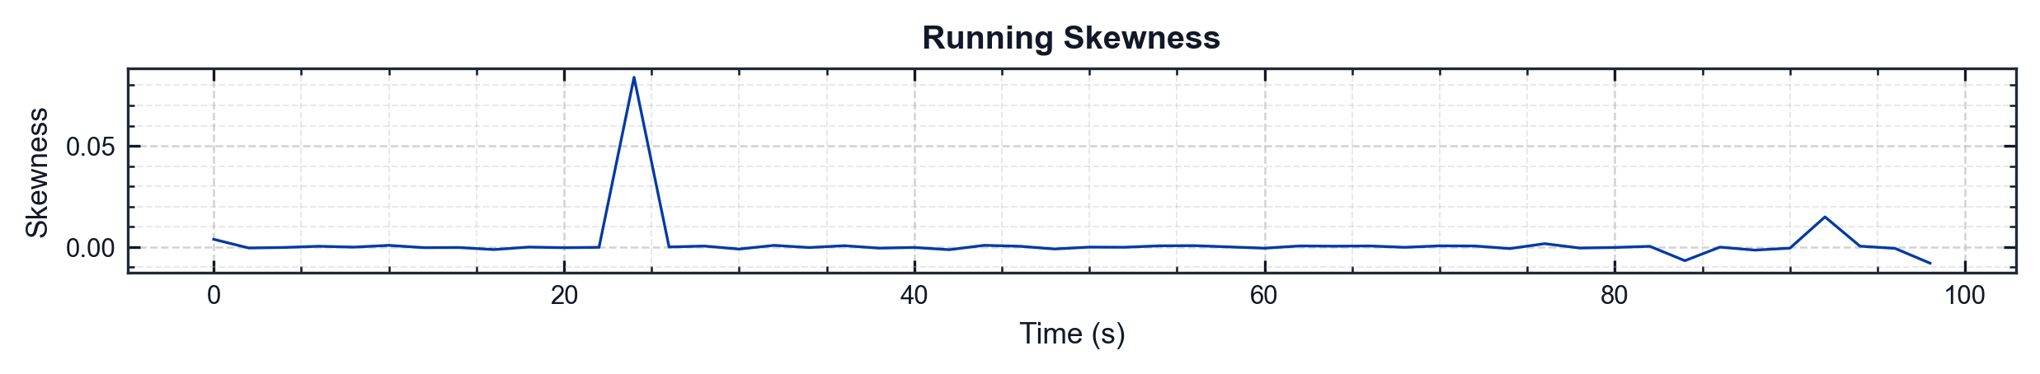
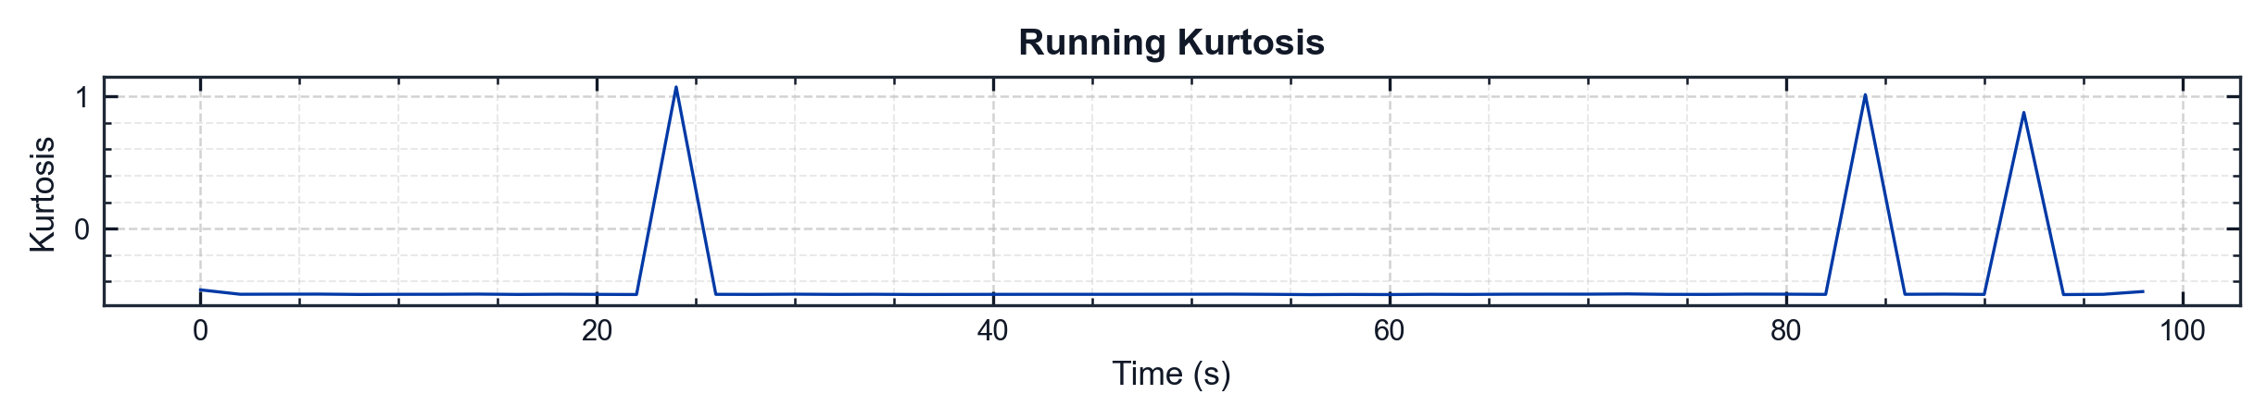
pyMARVIN v0.1.0 (Epic 1)
flight_001 | full_duration | accelerometer_z
Metric | Value
Mean | 0.0005 g
Std | 1.1742 g
Skewness | 0.0154
Kurtosis | -0.3113
Min | -6.5501 g
Max | 6.9692 g
RMS | 1.1742 g
Crest Factor | 5.9355
Conditioning | Filter: baseline+user (HP 1 Hz, LP 2000 Hz) | Running Mean Not Removed

Slide 9
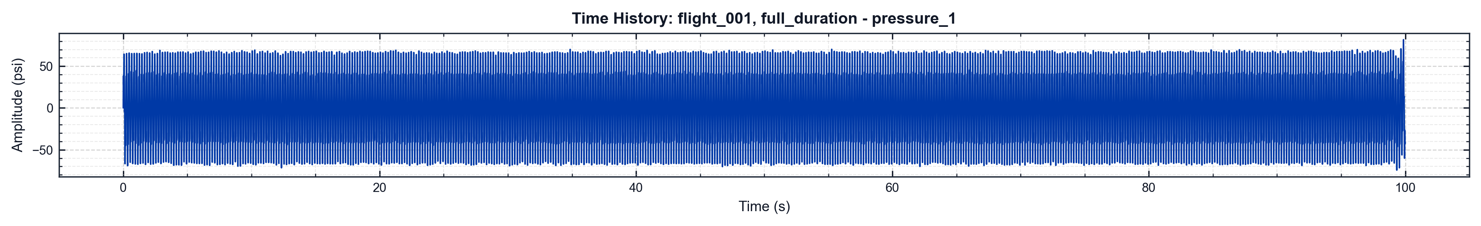
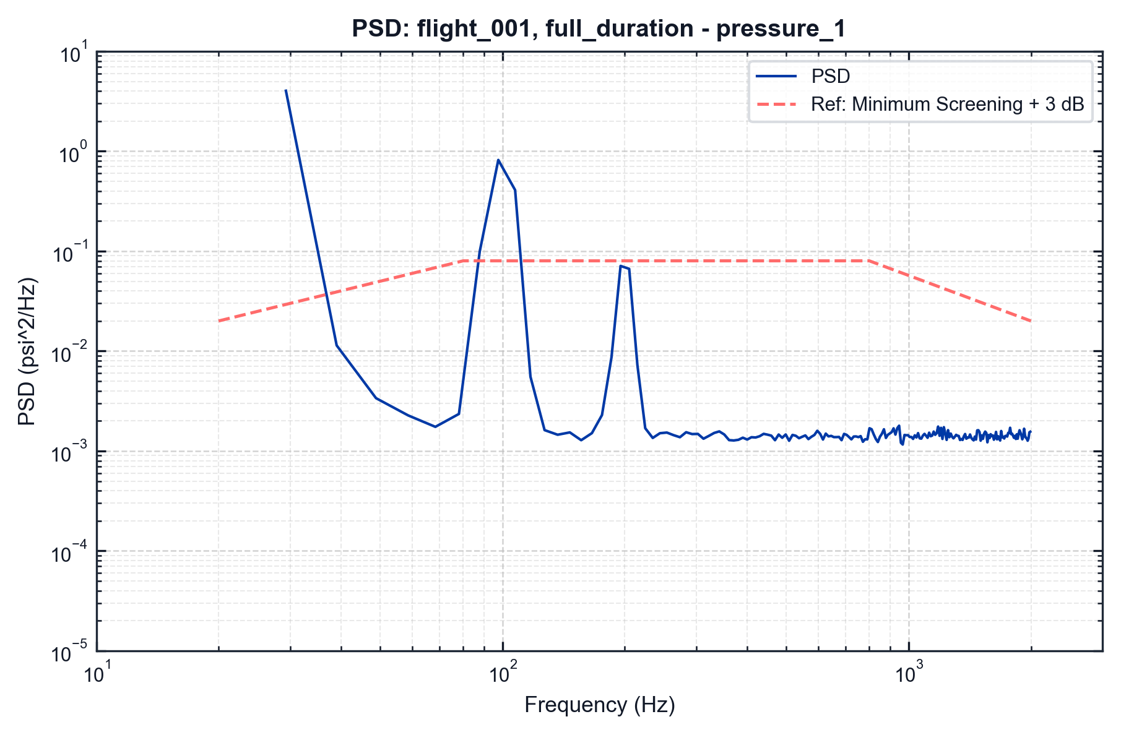
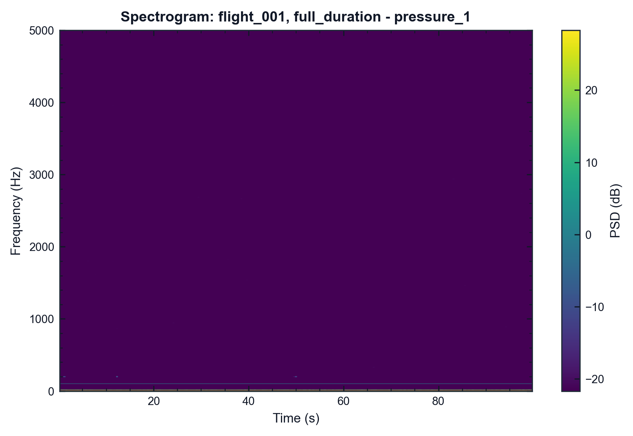
pyMARVIN v0.1.0 (Epic 1)
flight_001 | full_duration | pressure_1
df=5.0 Hz | spacing=constant_bandwidth | Fs=10000.0 Hz Event=full_duration (full duration) | Filter=None Method=Maximax | window=hann | overlap=50.0%
df=2.0 Hz | overlap=50.0% | SNR=50.0 dB Event=full_duration (full duration) | Fs=10000.0 Hz Colormap=viridis

Slide 10
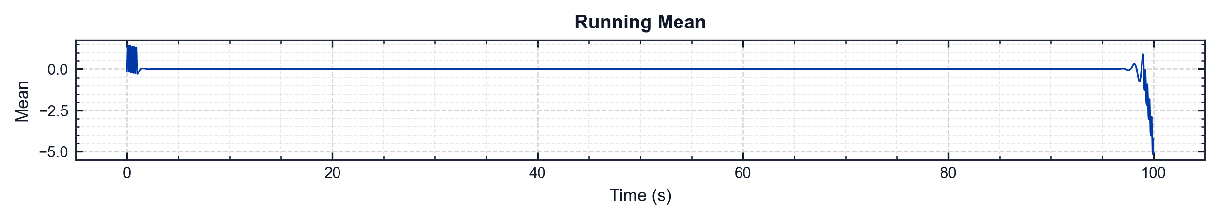
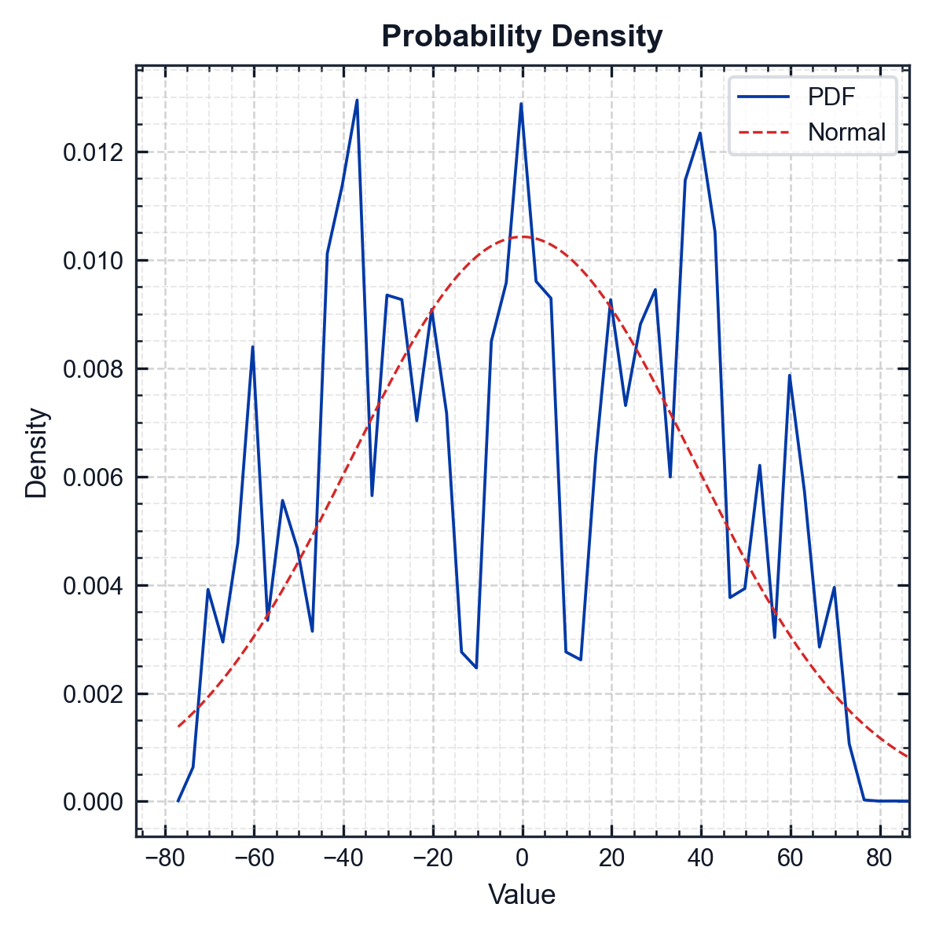
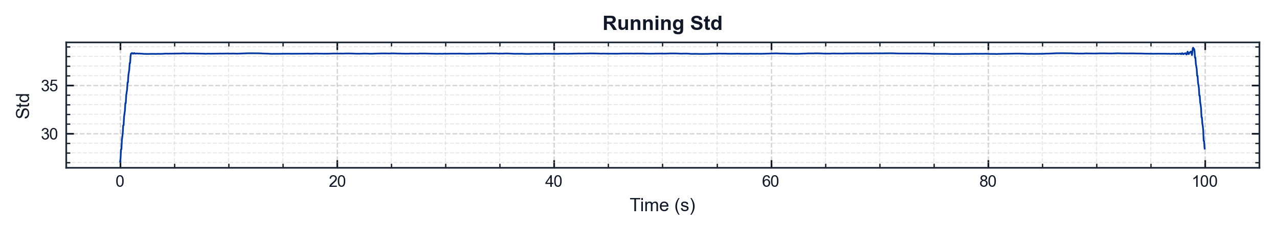
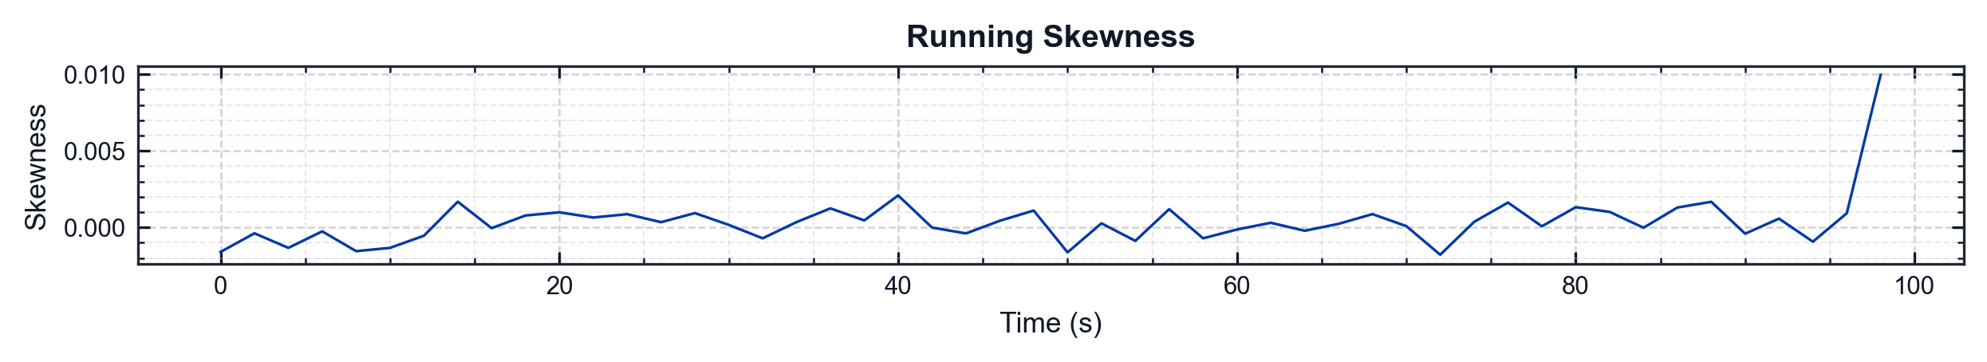
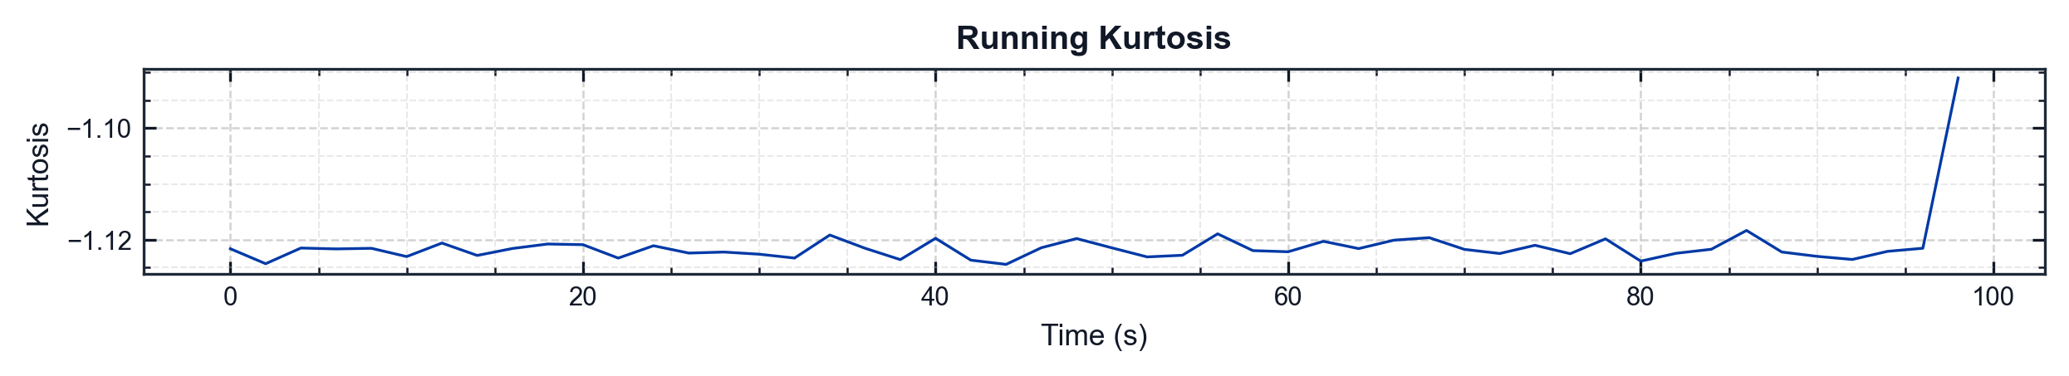
pyMARVIN v0.1.0 (Epic 1)
flight_001 | full_duration | pressure_1
Metric | Value
Mean | 0.0120 psi
Std | 38.2712 psi
Skewness | -0.0013
Kurtosis | -1.1223
Min | -78.6456 psi
Max | 88.1768 psi
RMS | 38.2712 psi
Crest Factor | 2.3040
Conditioning | Filter: baseline+user (HP 1 Hz, LP 2000 Hz) | Running Mean Not Removed

Slide 11
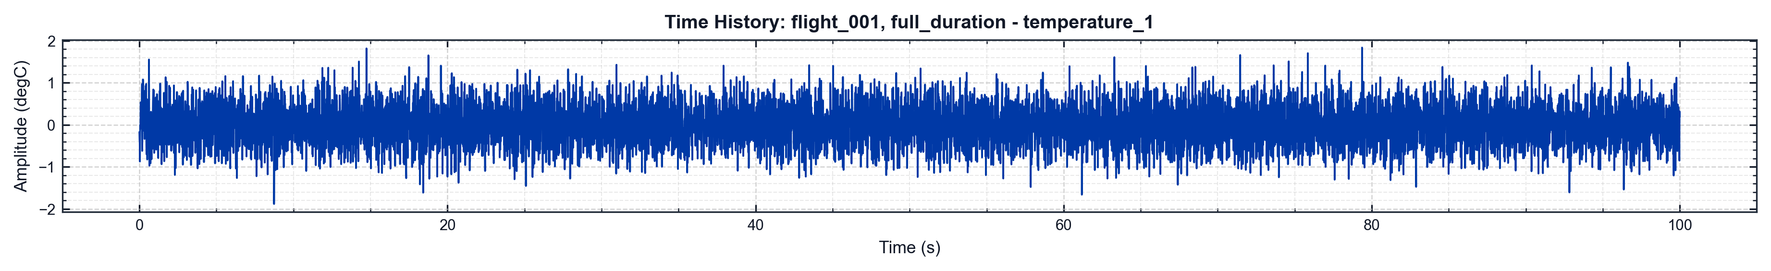
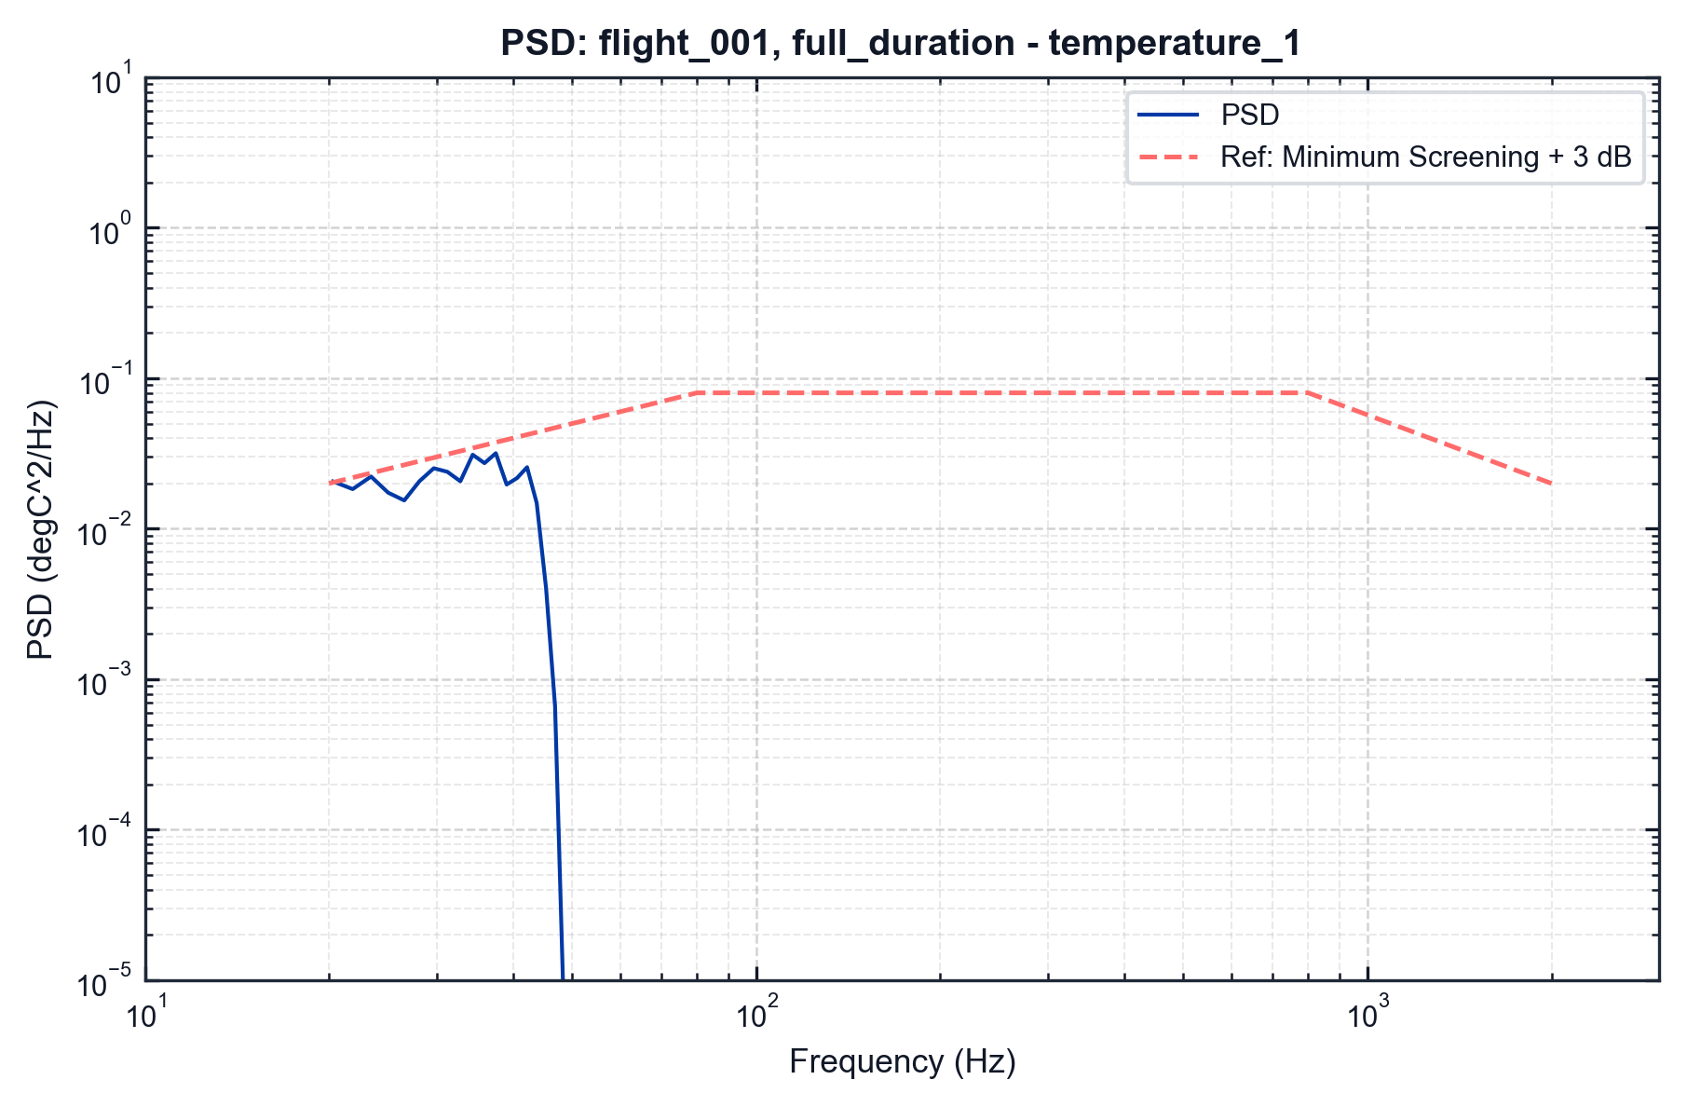
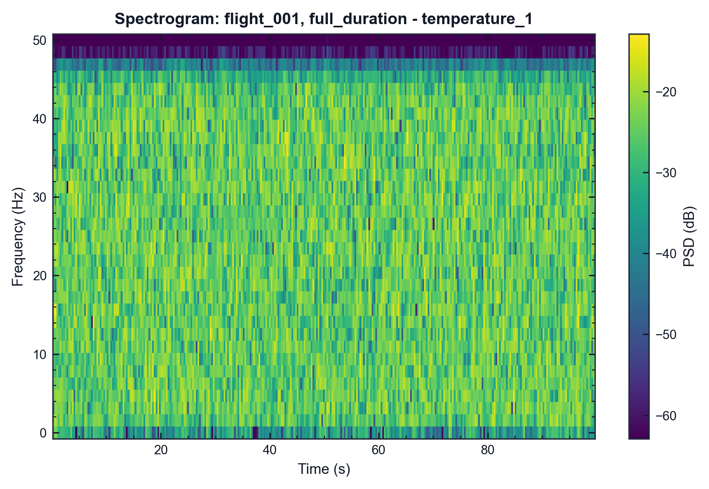
pyMARVIN v0.1.0 (Epic 1)
flight_001 | full_duration | temperature_1
df=5.0 Hz | spacing=constant_bandwidth | Fs=100.0 Hz Event=full_duration (full duration) | Filter=None Method=Maximax | window=hann | overlap=50.0%
df=2.0 Hz | overlap=50.0% | SNR=50.0 dB Event=full_duration (full duration) | Fs=100.0 Hz Colormap=viridis

Slide 12
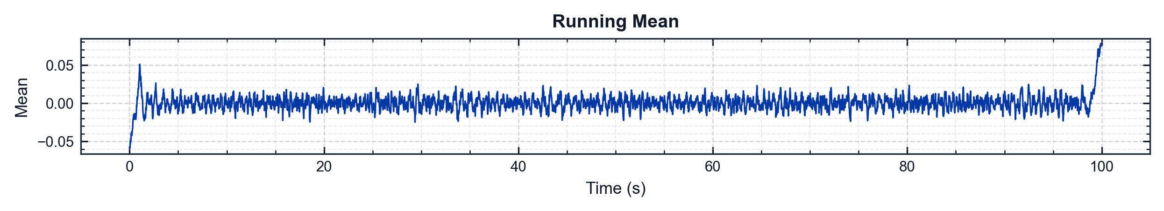
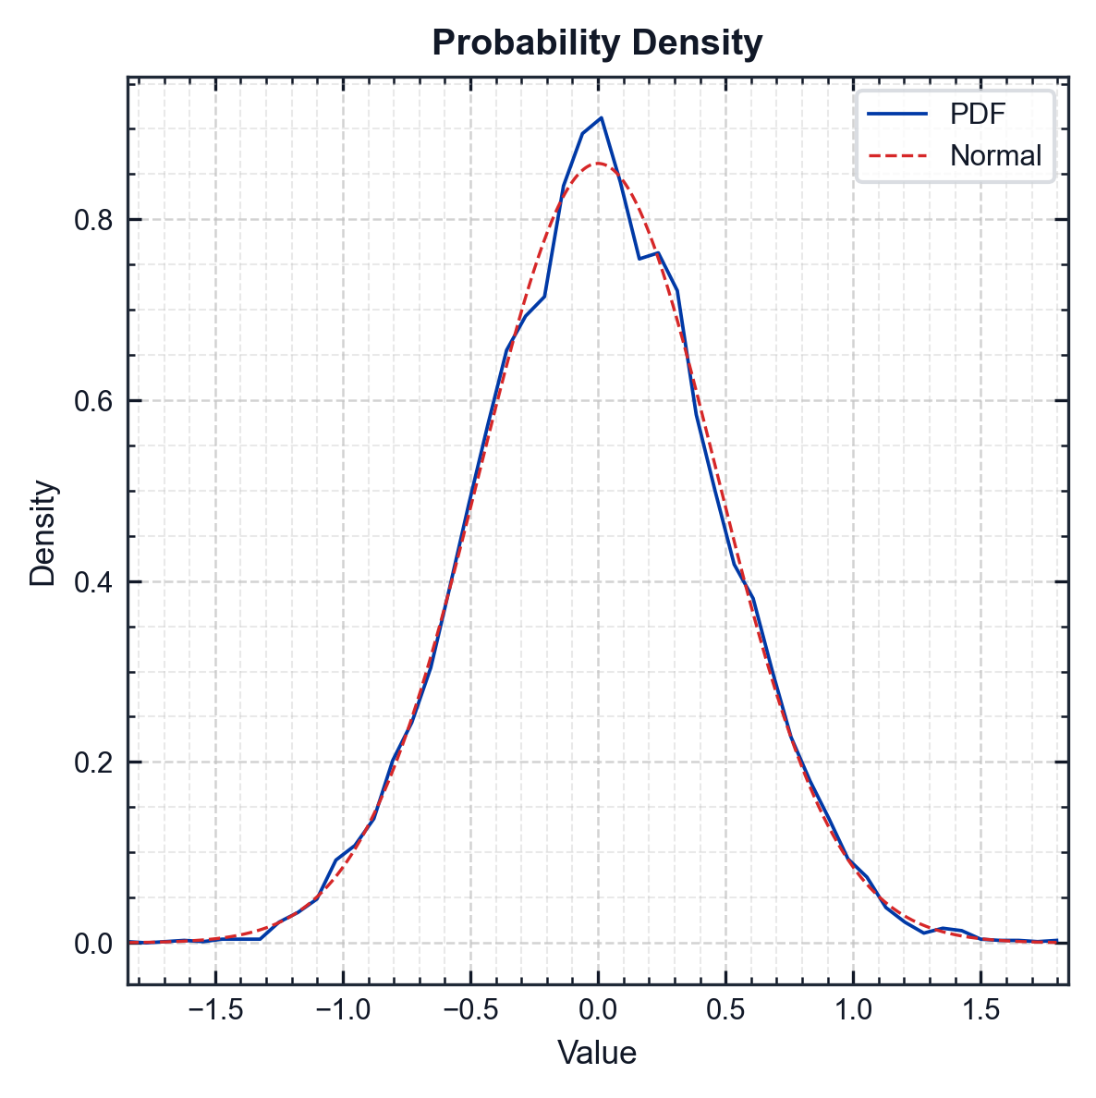
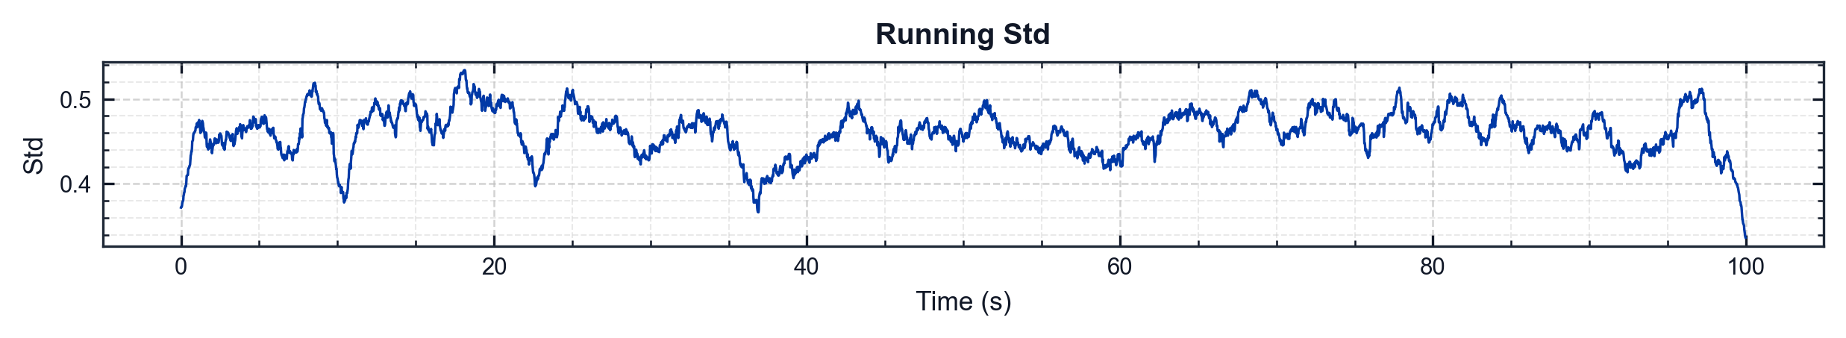
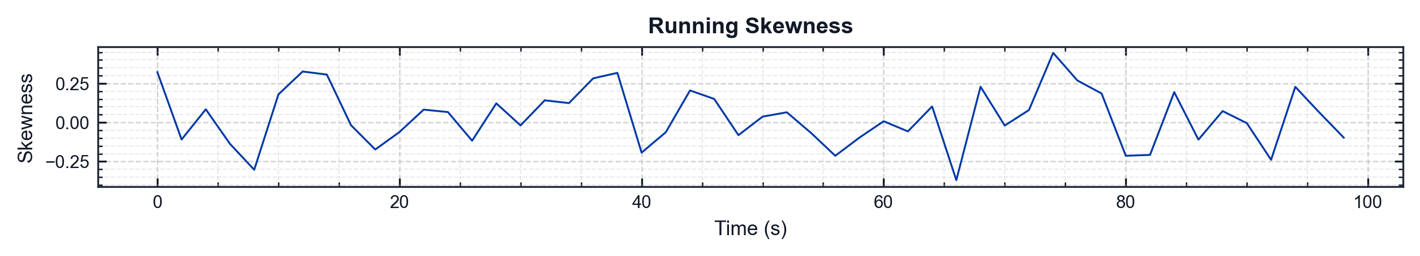
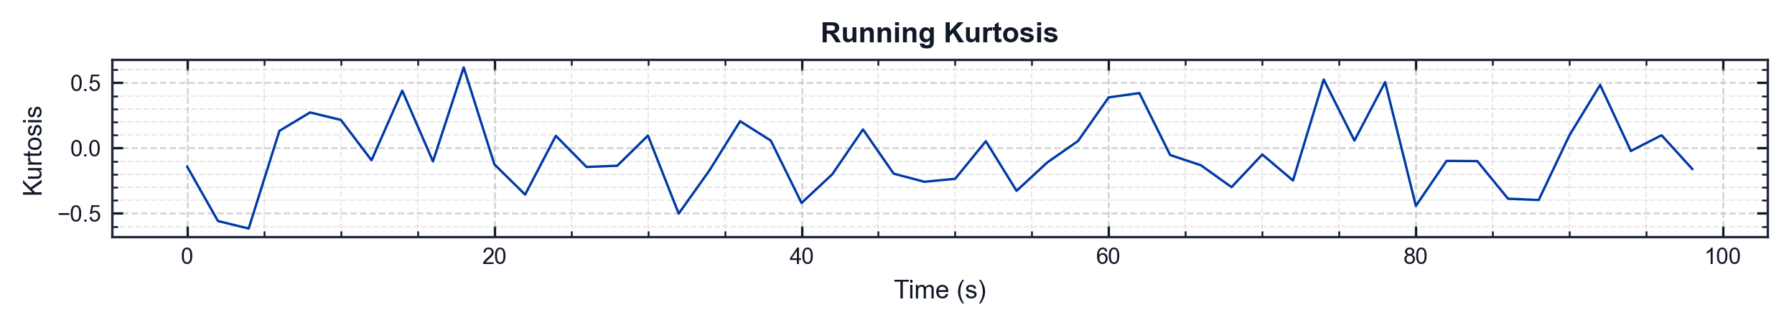
pyMARVIN v0.1.0 (Epic 1)
flight_001 | full_duration | temperature_1
Metric | Value
Mean | 0.0005 degC
Std | 0.4629 degC
Skewness | 0.0330
Kurtosis | -0.0082
Min | -1.8814 degC
Max | 1.8343 degC
RMS | 0.4629 degC
Crest Factor | 4.0643
Conditioning | Filter: baseline+user (HP 1 Hz, LP 2000 Hz) | Running Mean Not Removed

Slide 13
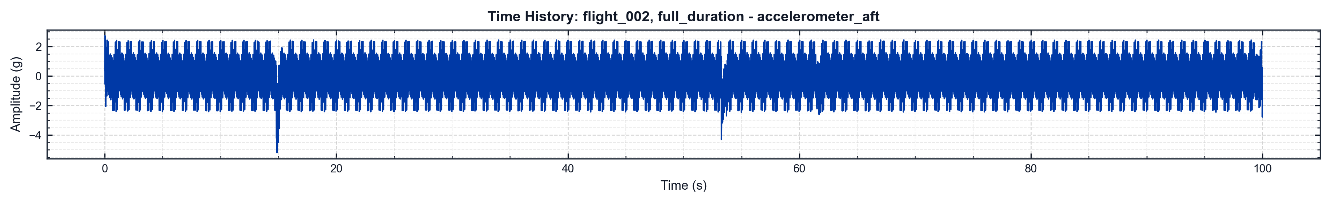
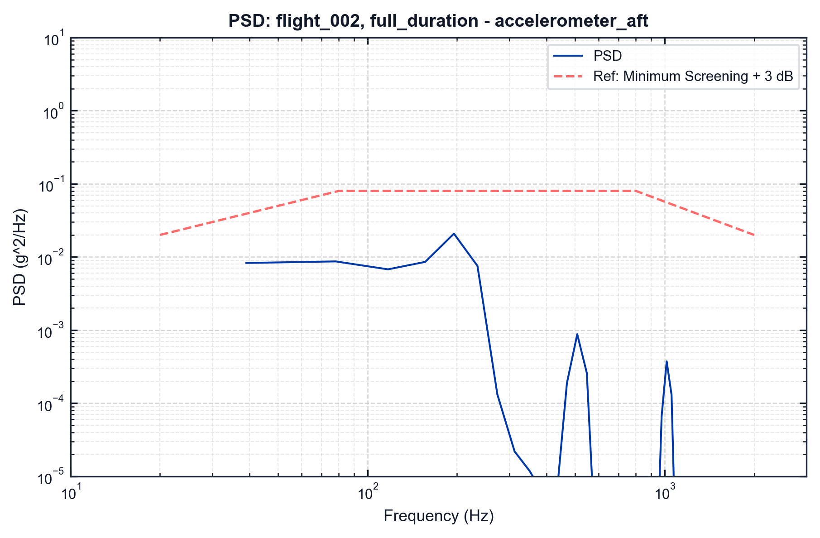

pyMARVIN v0.1.0 (Epic 1)
flight_002 | full_duration | accelerometer_aft
df=5.0 Hz | spacing=constant_bandwidth | Fs=40000.0 Hz Event=full_duration (full duration) | Filter=None Method=Maximax | window=hann | overlap=50.0%
df=2.0 Hz | overlap=50.0% | SNR=50.0 dB Event=full_duration (full duration) | Fs=40000.0 Hz Colormap=viridis

Slide 14
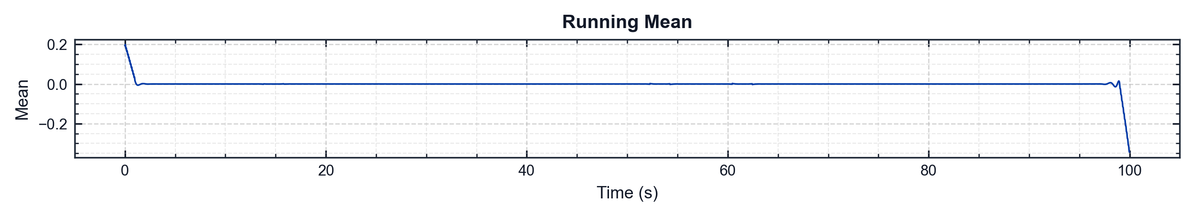
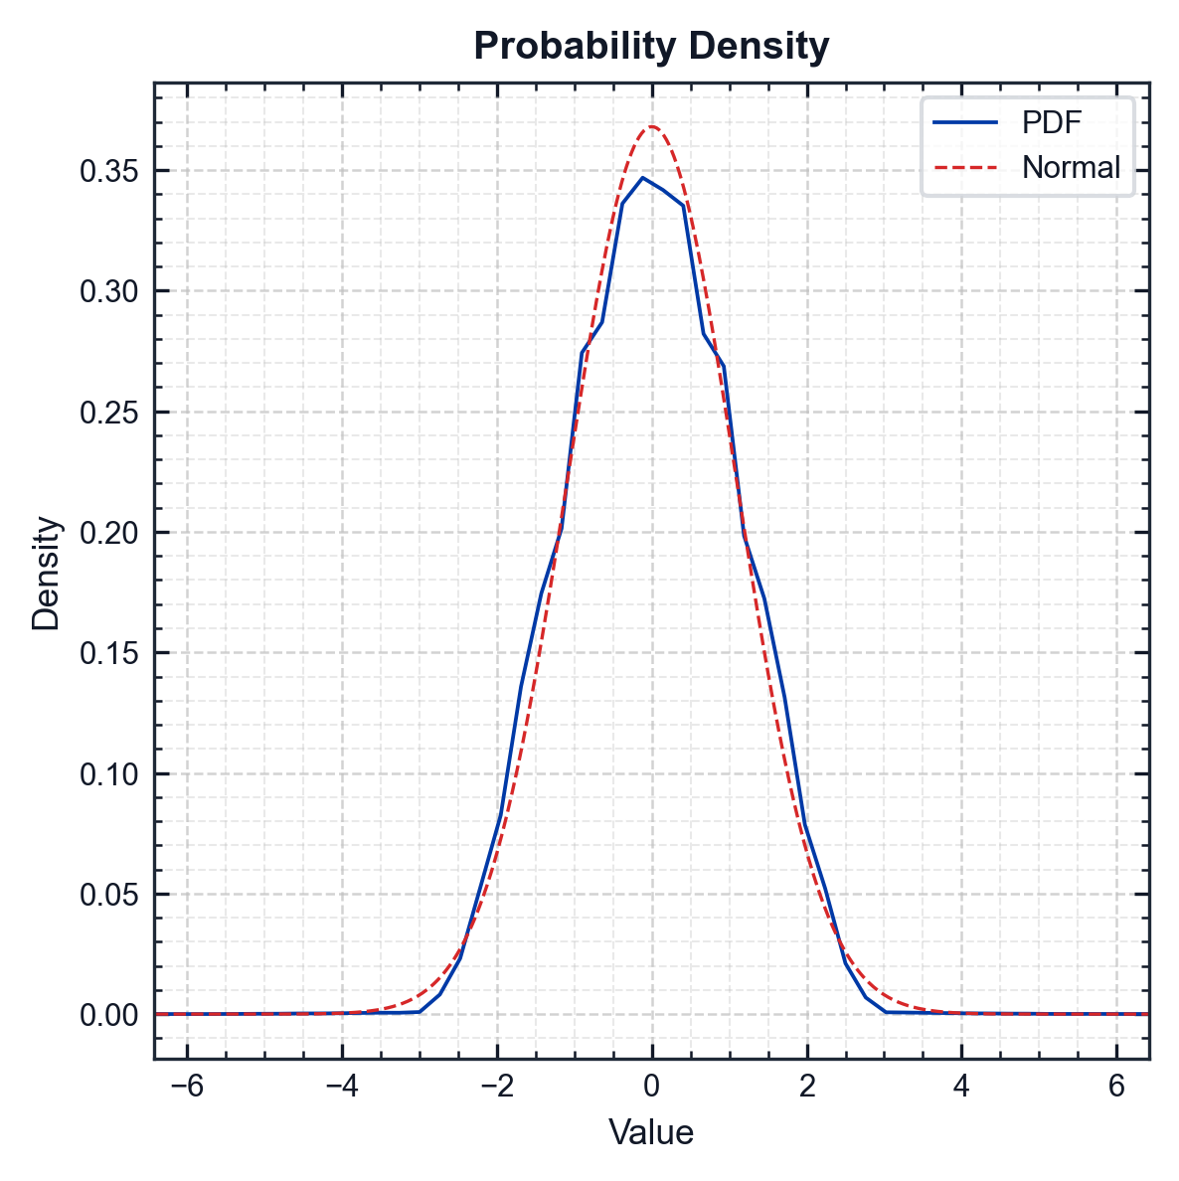
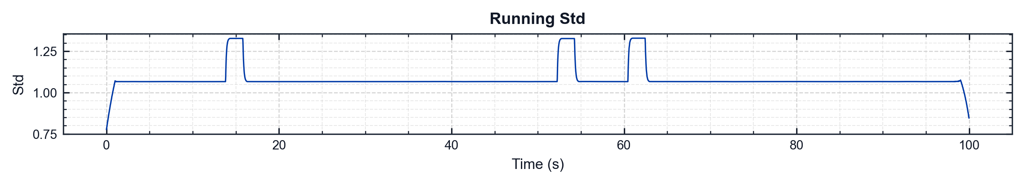
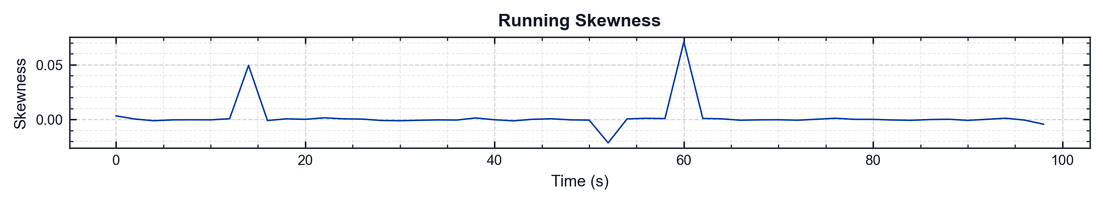
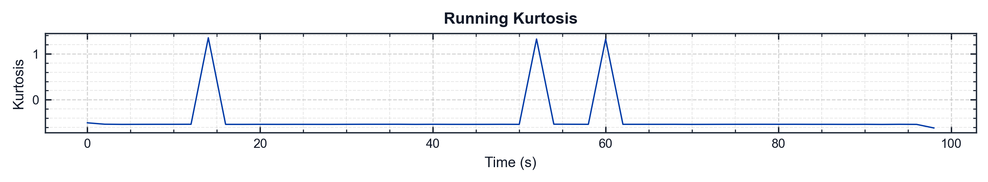
pyMARVIN v0.1.0 (Epic 1)
flight_002 | full_duration | accelerometer_aft
Metric | Value
Mean | 0.0005 g
Std | 1.0840 g
Skewness | -0.0005
Kurtosis | -0.2595
Min | -6.5362 g
Max | 6.5594 g
RMS | 1.0840 g
Crest Factor | 6.0510
Conditioning | Filter: baseline+user (HP 1 Hz, LP 2000 Hz) | Running Mean Not Removed

Slide 15
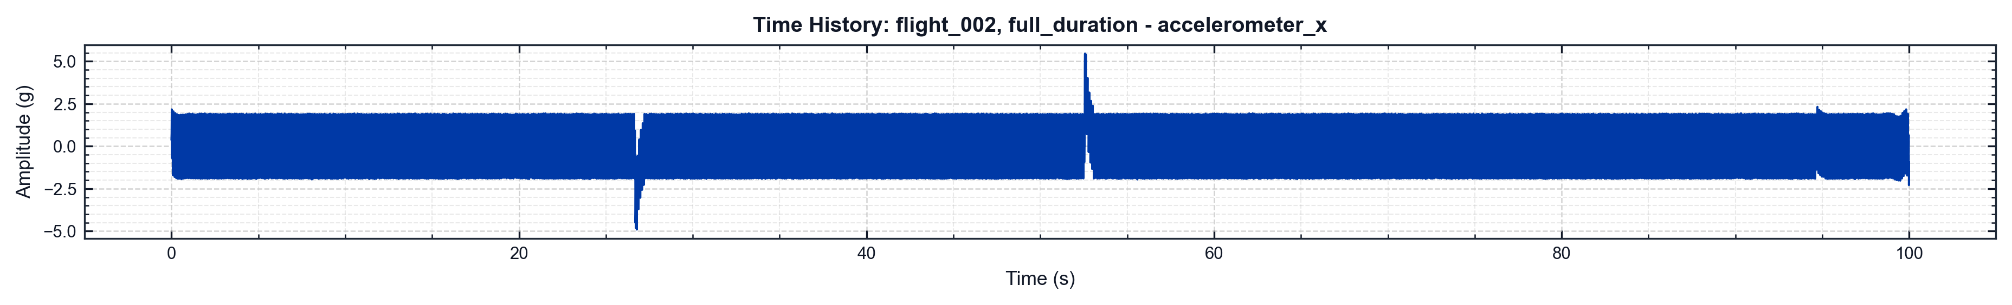


pyMARVIN v0.1.0 (Epic 1)
flight_002 | full_duration | accelerometer_x
df=5.0 Hz | spacing=constant_bandwidth | Fs=40000.0 Hz Event=full_duration (full duration) | Filter=None Method=Maximax | window=hann | overlap=50.0%
df=2.0 Hz | overlap=50.0% | SNR=50.0 dB Event=full_duration (full duration) | Fs=40000.0 Hz Colormap=viridis

Slide 16
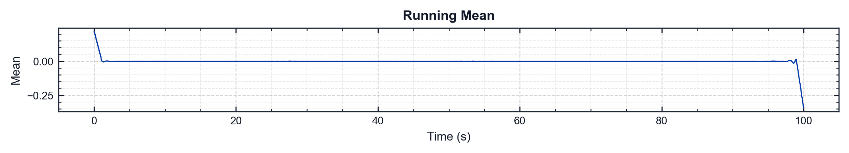
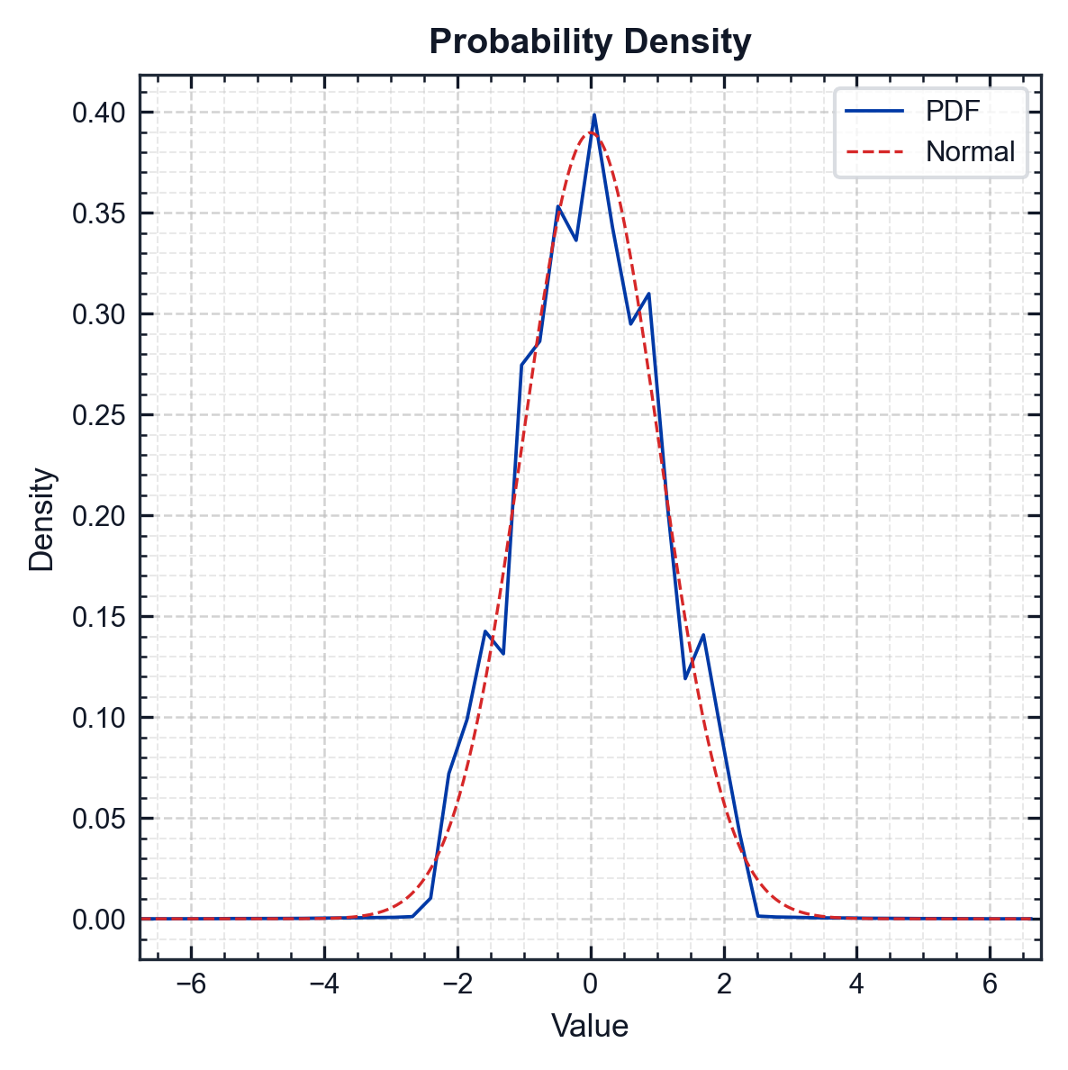
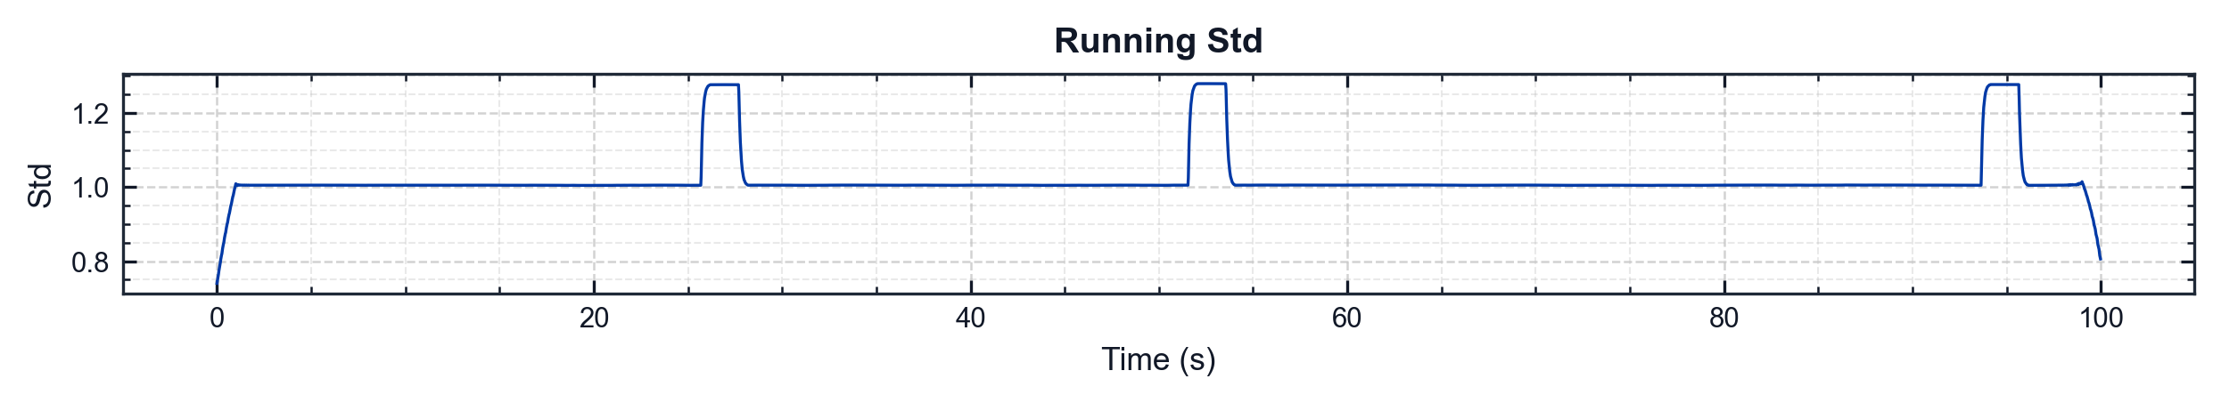


pyMARVIN v0.1.0 (Epic 1)
flight_002 | full_duration | accelerometer_x
Metric | Value
Mean | 0.0004 g
Std | 1.0238 g
Skewness | -0.0056
Kurtosis | -0.2250
Min | -6.9104 g
Max | 6.7509 g
RMS | 1.0238 g
Crest Factor | 6.7500
Conditioning | Filter: baseline+user (HP 1 Hz, LP 2000 Hz) | Running Mean Not Removed

Slide 17



pyMARVIN v0.1.0 (Epic 1)
flight_002 | full_duration | accelerometer_y
df=5.0 Hz | spacing=constant_bandwidth | Fs=40000.0 Hz Event=full_duration (full duration) | Filter=None Method=Maximax | window=hann | overlap=50.0%
df=2.0 Hz | overlap=50.0% | SNR=50.0 dB Event=full_duration (full duration) | Fs=40000.0 Hz Colormap=viridis

Slide 18





pyMARVIN v0.1.0 (Epic 1)
flight_002 | full_duration | accelerometer_y
Metric | Value
Mean | 0.0005 g
Std | 0.9893 g
Skewness | 0.0046
Kurtosis | -0.1006
Min | -6.7695 g
Max | 6.6875 g
RMS | 0.9893 g
Crest Factor | 6.8425
Conditioning | Filter: baseline+user (HP 1 Hz, LP 2000 Hz) | Running Mean Not Removed

Slide 19



pyMARVIN v0.1.0 (Epic 1)
flight_002 | full_duration | accelerometer_z
df=5.0 Hz | spacing=constant_bandwidth | Fs=40000.0 Hz Event=full_duration (full duration) | Filter=None Method=Maximax | window=hann | overlap=50.0%
df=2.0 Hz | overlap=50.0% | SNR=50.0 dB Event=full_duration (full duration) | Fs=40000.0 Hz Colormap=viridis

Slide 20





pyMARVIN v0.1.0 (Epic 1)
flight_002 | full_duration | accelerometer_z
Metric | Value
Mean | 0.0005 g
Std | 1.1743 g
Skewness | -0.0071
Kurtosis | -0.3086
Min | -6.4771 g
Max | 6.3435 g
RMS | 1.1743 g
Crest Factor | 5.5156
Conditioning | Filter: baseline+user (HP 1 Hz, LP 2000 Hz) | Running Mean Not Removed

Slide 21



pyMARVIN v0.1.0 (Epic 1)
flight_002 | full_duration | pressure_1
df=5.0 Hz | spacing=constant_bandwidth | Fs=10000.0 Hz Event=full_duration (full duration) | Filter=None Method=Maximax | window=hann | overlap=50.0%
df=2.0 Hz | overlap=50.0% | SNR=50.0 dB Event=full_duration (full duration) | Fs=10000.0 Hz Colormap=viridis

Slide 22





pyMARVIN v0.1.0 (Epic 1)
flight_002 | full_duration | pressure_1
Metric | Value
Mean | 0.0172 psi
Std | 38.2790 psi
Skewness | -0.0017
Kurtosis | -1.1090
Min | -80.2453 psi
Max | 90.1946 psi
RMS | 38.2790 psi
Crest Factor | 2.3562
Conditioning | Filter: baseline+user (HP 1 Hz, LP 2000 Hz) | Running Mean Not Removed

Slide 23



pyMARVIN v0.1.0 (Epic 1)
flight_002 | full_duration | temperature_1
df=5.0 Hz | spacing=constant_bandwidth | Fs=100.0 Hz Event=full_duration (full duration) | Filter=None Method=Maximax | window=hann | overlap=50.0%
df=2.0 Hz | overlap=50.0% | SNR=50.0 dB Event=full_duration (full duration) | Fs=100.0 Hz Colormap=viridis

Slide 24





pyMARVIN v0.1.0 (Epic 1)
flight_002 | full_duration | temperature_1
Metric | Value
Mean | 0.0003 degC
Std | 0.4666 degC
Skewness | 0.0338
Kurtosis | -0.0637
Min | -1.6408 degC
Max | 1.7002 degC
RMS | 0.4666 degC
Crest Factor | 3.6439
Conditioning | Filter: baseline+user (HP 1 Hz, LP 2000 Hz) | Running Mean Not Removed

Slide 25



pyMARVIN v0.1.0 (Epic 1)
flight_001 | Start | accelerometer_x
df=5.0 Hz | spacing=constant_bandwidth | Fs=40000.0 Hz Event=Start (0.00-10.00s) | Filter=None Method=Maximax | window=hann | overlap=50.0%
df=2.0 Hz | overlap=50.0% | SNR=50.0 dB Event=Start (0.00-10.00s) | Fs=40000.0 Hz Colormap=viridis

Slide 26





pyMARVIN v0.1.0 (Epic 1)
flight_001 | Start | accelerometer_x
Metric | Value
Mean | 0.0041 g
Std | 1.0086 g
Skewness | 0.0054
Kurtosis | -0.5378
Min | -2.7911 g
Max | 2.6565 g
RMS | 1.0086 g
Crest Factor | 2.7674
Conditioning | Filter: baseline+user (HP 1 Hz, LP 2000 Hz) | Running Mean Not Removed

Slide 27



pyMARVIN v0.1.0 (Epic 1)
flight_001 | Start | accelerometer_y
df=5.0 Hz | spacing=constant_bandwidth | Fs=40000.0 Hz Event=Start (0.00-10.00s) | Filter=None Method=Maximax | window=hann | overlap=50.0%
df=2.0 Hz | overlap=50.0% | SNR=50.0 dB Event=Start (0.00-10.00s) | Fs=40000.0 Hz Colormap=viridis

Slide 28





pyMARVIN v0.1.0 (Epic 1)
flight_001 | Start | accelerometer_y
Metric | Value
Mean | 0.0056 g
Std | 1.0362 g
Skewness | 0.0187
Kurtosis | 0.6257
Min | -6.0538 g
Max | 5.8032 g
RMS | 1.0362 g
Crest Factor | 5.8422
Conditioning | Filter: baseline+user (HP 1 Hz, LP 2000 Hz) | Running Mean Not Removed

Slide 29



pyMARVIN v0.1.0 (Epic 1)
flight_001 | Start | accelerometer_z
df=5.0 Hz | spacing=constant_bandwidth | Fs=40000.0 Hz Event=Start (0.00-10.00s) | Filter=None Method=Maximax | window=hann | overlap=50.0%
df=2.0 Hz | overlap=50.0% | SNR=50.0 dB Event=Start (0.00-10.00s) | Fs=40000.0 Hz Colormap=viridis

Slide 30





pyMARVIN v0.1.0 (Epic 1)
flight_001 | Start | accelerometer_z
Metric | Value
Mean | 0.0055 g
Std | 1.1624 g
Skewness | -0.0064
Kurtosis | -0.4865
Min | -3.3880 g
Max | 3.3774 g
RMS | 1.1624 g
Crest Factor | 2.9148
Conditioning | Filter: baseline+user (HP 1 Hz, LP 2000 Hz) | Running Mean Not Removed

Slide 31



pyMARVIN v0.1.0 (Epic 1)
flight_001 | Start | pressure_1
df=5.0 Hz | spacing=constant_bandwidth | Fs=10000.0 Hz Event=Start (0.00-10.00s) | Filter=None Method=Maximax | window=hann | overlap=50.0%
df=2.0 Hz | overlap=50.0% | SNR=50.0 dB Event=Start (0.00-10.00s) | Fs=10000.0 Hz Colormap=viridis

Slide 32





pyMARVIN v0.1.0 (Epic 1)
flight_001 | Start | pressure_1
Metric | Value
Mean | 0.1203 psi
Std | 38.3292 psi
Skewness | 0.0009
Kurtosis | -1.1155
Min | -77.0712 psi
Max | 86.8759 psi
RMS | 38.3294 psi
Crest Factor | 2.2666
Conditioning | Filter: baseline+user (HP 1 Hz, LP 2000 Hz) | Running Mean Not Removed

Slide 33



pyMARVIN v0.1.0 (Epic 1)
flight_001 | Start | temperature_1
df=5.0 Hz | spacing=constant_bandwidth | Fs=100.0 Hz Event=Start (0.00-10.00s) | Filter=None Method=Maximax | window=hann | overlap=50.0%
df=2.0 Hz | overlap=50.0% | SNR=50.0 dB Event=Start (0.00-10.00s) | Fs=100.0 Hz Colormap=viridis

Slide 34





pyMARVIN v0.1.0 (Epic 1)
flight_001 | Start | temperature_1
Metric | Value
Mean | 0.0046 degC
Std | 0.4658 degC
Skewness | -0.0318
Kurtosis | -0.1401
Min | -1.8810 degC
Max | 1.5505 degC
RMS | 0.4658 degC
Crest Factor | 4.0381
Conditioning | Filter: baseline+user (HP 1 Hz, LP 2000 Hz) | Running Mean Not Removed

Slide 35



pyMARVIN v0.1.0 (Epic 1)
flight_002 | Start | accelerometer_aft
df=5.0 Hz | spacing=constant_bandwidth | Fs=40000.0 Hz Event=Start (0.00-10.00s) | Filter=None Method=Maximax | window=hann | overlap=50.0%
df=2.0 Hz | overlap=50.0% | SNR=50.0 dB Event=Start (0.00-10.00s) | Fs=40000.0 Hz Colormap=viridis

Slide 36





pyMARVIN v0.1.0 (Epic 1)
flight_002 | Start | accelerometer_aft
Metric | Value
Mean | 0.0046 g
Std | 1.0700 g
Skewness | -0.0005
Kurtosis | -0.5491
Min | -3.0479 g
Max | 2.9690 g
RMS | 1.0701 g
Crest Factor | 2.8484
Conditioning | Filter: baseline+user (HP 1 Hz, LP 2000 Hz) | Running Mean Not Removed

Slide 37



pyMARVIN v0.1.0 (Epic 1)
flight_002 | Start | accelerometer_x
df=5.0 Hz | spacing=constant_bandwidth | Fs=40000.0 Hz Event=Start (0.00-10.00s) | Filter=None Method=Maximax | window=hann | overlap=50.0%
df=2.0 Hz | overlap=50.0% | SNR=50.0 dB Event=Start (0.00-10.00s) | Fs=40000.0 Hz Colormap=viridis

Slide 38





pyMARVIN v0.1.0 (Epic 1)
flight_002 | Start | accelerometer_x
Metric | Value
Mean | 0.0042 g
Std | 1.0089 g
Skewness | 0.0035
Kurtosis | -0.5250
Min | -2.8276 g
Max | 2.6574 g
RMS | 1.0089 g
Crest Factor | 2.8027
Conditioning | Filter: baseline+user (HP 1 Hz, LP 2000 Hz) | Running Mean Not Removed

Slide 39



pyMARVIN v0.1.0 (Epic 1)
flight_002 | Start | accelerometer_y
df=5.0 Hz | spacing=constant_bandwidth | Fs=40000.0 Hz Event=Start (0.00-10.00s) | Filter=None Method=Maximax | window=hann | overlap=50.0%
df=2.0 Hz | overlap=50.0% | SNR=50.0 dB Event=Start (0.00-10.00s) | Fs=40000.0 Hz Colormap=viridis

Slide 40





pyMARVIN v0.1.0 (Epic 1)
flight_002 | Start | accelerometer_y
Metric | Value
Mean | 0.0054 g
Std | 0.9756 g
Skewness | -0.0043
Kurtosis | -0.4187
Min | -3.3802 g
Max | 3.0833 g
RMS | 0.9756 g
Crest Factor | 3.4647
Conditioning | Filter: baseline+user (HP 1 Hz, LP 2000 Hz) | Running Mean Not Removed

Slide 41



pyMARVIN v0.1.0 (Epic 1)
flight_002 | Start | accelerometer_z
df=5.0 Hz | spacing=constant_bandwidth | Fs=40000.0 Hz Event=Start (0.00-10.00s) | Filter=None Method=Maximax | window=hann | overlap=50.0%
df=2.0 Hz | overlap=50.0% | SNR=50.0 dB Event=Start (0.00-10.00s) | Fs=40000.0 Hz Colormap=viridis

Slide 42





pyMARVIN v0.1.0 (Epic 1)
flight_002 | Start | accelerometer_z
Metric | Value
Mean | 0.0053 g
Std | 1.1619 g
Skewness | 0.0005
Kurtosis | -0.4777
Min | -3.3073 g
Max | 3.3811 g
RMS | 1.1619 g
Crest Factor | 2.9100
Conditioning | Filter: baseline+user (HP 1 Hz, LP 2000 Hz) | Running Mean Not Removed

Slide 43



pyMARVIN v0.1.0 (Epic 1)
flight_002 | Start | pressure_1
df=5.0 Hz | spacing=constant_bandwidth | Fs=10000.0 Hz Event=Start (0.00-10.00s) | Filter=None Method=Maximax | window=hann | overlap=50.0%
df=2.0 Hz | overlap=50.0% | SNR=50.0 dB Event=Start (0.00-10.00s) | Fs=10000.0 Hz Colormap=viridis

Slide 44





pyMARVIN v0.1.0 (Epic 1)
flight_002 | Start | pressure_1
Metric | Value
Mean | 0.1719 psi
Std | 38.4142 psi
Skewness | 0.0034
Kurtosis | -1.1158
Min | -78.7505 psi
Max | 89.0578 psi
RMS | 38.4146 psi
Crest Factor | 2.3183
Conditioning | Filter: baseline+user (HP 1 Hz, LP 2000 Hz) | Running Mean Not Removed

Slide 45



pyMARVIN v0.1.0 (Epic 1)
flight_002 | Start | temperature_1
df=5.0 Hz | spacing=constant_bandwidth | Fs=100.0 Hz Event=Start (0.00-10.00s) | Filter=None Method=Maximax | window=hann | overlap=50.0%
df=2.0 Hz | overlap=50.0% | SNR=50.0 dB Event=Start (0.00-10.00s) | Fs=100.0 Hz Colormap=viridis

Slide 46





pyMARVIN v0.1.0 (Epic 1)
flight_002 | Start | temperature_1
Metric | Value
Mean | 0.0095 degC
Std | 0.4648 degC
Skewness | 0.0512
Kurtosis | 0.0913
Min | -1.4611 degC
Max | 1.5643 degC
RMS | 0.4649 degC
Crest Factor | 3.3647
Conditioning | Filter: baseline+user (HP 1 Hz, LP 2000 Hz) | Running Mean Not Removed

Slide 47



pyMARVIN v0.1.0 (Epic 1)
flight_001 | Middle | accelerometer_x
df=5.0 Hz | spacing=constant_bandwidth | Fs=40000.0 Hz Event=Middle (40.00-60.00s) | Filter=None Method=Maximax | window=hann | overlap=50.0%
df=2.0 Hz | overlap=50.0% | SNR=50.0 dB Event=Middle (40.00-60.00s) | Fs=40000.0 Hz Colormap=viridis

Slide 48





pyMARVIN v0.1.0 (Epic 1)
flight_001 | Middle | accelerometer_x
Metric | Value
Mean | 0.0024 g
Std | 1.0067 g
Skewness | 0.0024
Kurtosis | -0.5391
Min | -2.7388 g
Max | 2.6684 g
RMS | 1.0067 g
Crest Factor | 2.7205
Conditioning | Filter: baseline+user (HP 1 Hz, LP 2000 Hz) | Running Mean Not Removed

Slide 49



pyMARVIN v0.1.0 (Epic 1)
flight_001 | Middle | accelerometer_y
df=5.0 Hz | spacing=constant_bandwidth | Fs=40000.0 Hz Event=Middle (40.00-60.00s) | Filter=None Method=Maximax | window=hann | overlap=50.0%
df=2.0 Hz | overlap=50.0% | SNR=50.0 dB Event=Middle (40.00-60.00s) | Fs=40000.0 Hz Colormap=viridis

Slide 50





pyMARVIN v0.1.0 (Epic 1)
flight_001 | Middle | accelerometer_y
Metric | Value
Mean | 0.0025 g
Std | 1.0035 g
Skewness | 0.0155
Kurtosis | 0.1015
Min | -5.6573 g
Max | 6.0974 g
RMS | 1.0035 g
Crest Factor | 6.0764
Conditioning | Filter: baseline+user (HP 1 Hz, LP 2000 Hz) | Running Mean Not Removed

Slide 51



pyMARVIN v0.1.0 (Epic 1)
flight_001 | Middle | accelerometer_z
df=5.0 Hz | spacing=constant_bandwidth | Fs=40000.0 Hz Event=Middle (40.00-60.00s) | Filter=None Method=Maximax | window=hann | overlap=50.0%
df=2.0 Hz | overlap=50.0% | SNR=50.0 dB Event=Middle (40.00-60.00s) | Fs=40000.0 Hz Colormap=viridis

Slide 52





pyMARVIN v0.1.0 (Epic 1)
flight_001 | Middle | accelerometer_z
Metric | Value
Mean | 0.0021 g
Std | 1.1602 g
Skewness | -0.0075
Kurtosis | -0.4881
Min | -3.4508 g
Max | 3.3220 g
RMS | 1.1602 g
Crest Factor | 2.9744
Conditioning | Filter: baseline+user (HP 1 Hz, LP 2000 Hz) | Running Mean Not Removed

Slide 53



pyMARVIN v0.1.0 (Epic 1)
flight_001 | Middle | pressure_1
df=5.0 Hz | spacing=constant_bandwidth | Fs=10000.0 Hz Event=Middle (40.00-60.00s) | Filter=None Method=Maximax | window=hann | overlap=50.0%
df=2.0 Hz | overlap=50.0% | SNR=50.0 dB Event=Middle (40.00-60.00s) | Fs=10000.0 Hz Colormap=viridis

Slide 54





pyMARVIN v0.1.0 (Epic 1)
flight_001 | Middle | pressure_1
Metric | Value
Mean | 0.0681 psi
Std | 38.2929 psi
Skewness | 0.0076
Kurtosis | -1.1211
Min | -78.6425 psi
Max | 86.2774 psi
RMS | 38.2930 psi
Crest Factor | 2.2531
Conditioning | Filter: baseline+user (HP 1 Hz, LP 2000 Hz) | Running Mean Not Removed

Slide 55



pyMARVIN v0.1.0 (Epic 1)
flight_001 | Middle | temperature_1
df=5.0 Hz | spacing=constant_bandwidth | Fs=100.0 Hz Event=Middle (40.00-60.00s) | Filter=None Method=Maximax | window=hann | overlap=50.0%
df=2.0 Hz | overlap=50.0% | SNR=50.0 dB Event=Middle (40.00-60.00s) | Fs=100.0 Hz Colormap=viridis

Slide 56





pyMARVIN v0.1.0 (Epic 1)
flight_001 | Middle | temperature_1
Metric | Value
Mean | 0.0073 degC
Std | 0.4587 degC
Skewness | -0.0177
Kurtosis | -0.1436
Min | -1.4761 degC
Max | 1.4155 degC
RMS | 0.4587 degC
Crest Factor | 3.2178
Conditioning | Filter: baseline+user (HP 1 Hz, LP 2000 Hz) | Running Mean Not Removed

Slide 57



pyMARVIN v0.1.0 (Epic 1)
flight_002 | Middle | accelerometer_aft
df=5.0 Hz | spacing=constant_bandwidth | Fs=40000.0 Hz Event=Middle (40.00-60.00s) | Filter=None Method=Maximax | window=hann | overlap=50.0%
df=2.0 Hz | overlap=50.0% | SNR=50.0 dB Event=Middle (40.00-60.00s) | Fs=40000.0 Hz Colormap=viridis

Slide 58





pyMARVIN v0.1.0 (Epic 1)
flight_002 | Middle | accelerometer_aft
Metric | Value
Mean | 0.0021 g
Std | 1.0966 g
Skewness | -0.0141
Kurtosis | -0.1142
Min | -6.3835 g
Max | 6.5594 g
RMS | 1.0966 g
Crest Factor | 5.9818
Conditioning | Filter: baseline+user (HP 1 Hz, LP 2000 Hz) | Running Mean Not Removed

Slide 59



pyMARVIN v0.1.0 (Epic 1)
flight_002 | Middle | accelerometer_x
df=5.0 Hz | spacing=constant_bandwidth | Fs=40000.0 Hz Event=Middle (40.00-60.00s) | Filter=None Method=Maximax | window=hann | overlap=50.0%
df=2.0 Hz | overlap=50.0% | SNR=50.0 dB Event=Middle (40.00-60.00s) | Fs=40000.0 Hz Colormap=viridis

Slide 60





pyMARVIN v0.1.0 (Epic 1)
flight_002 | Middle | accelerometer_x
Metric | Value
Mean | 0.0025 g
Std | 1.0375 g
Skewness | -0.0069
Kurtosis | 0.0140
Min | -6.2966 g
Max | 5.8034 g
RMS | 1.0375 g
Crest Factor | 6.0691
Conditioning | Filter: baseline+user (HP 1 Hz, LP 2000 Hz) | Running Mean Not Removed

Slide 61



pyMARVIN v0.1.0 (Epic 1)
flight_002 | Middle | accelerometer_y
df=5.0 Hz | spacing=constant_bandwidth | Fs=40000.0 Hz Event=Middle (40.00-60.00s) | Filter=None Method=Maximax | window=hann | overlap=50.0%
df=2.0 Hz | overlap=50.0% | SNR=50.0 dB Event=Middle (40.00-60.00s) | Fs=40000.0 Hz Colormap=viridis

Slide 62





pyMARVIN v0.1.0 (Epic 1)
flight_002 | Middle | accelerometer_y
Metric | Value
Mean | 0.0023 g
Std | 1.0036 g
Skewness | -0.0012
Kurtosis | 0.1037
Min | -6.3278 g
Max | 6.6875 g
RMS | 1.0036 g
Crest Factor | 6.6637
Conditioning | Filter: baseline+user (HP 1 Hz, LP 2000 Hz) | Running Mean Not Removed

Slide 63



pyMARVIN v0.1.0 (Epic 1)
flight_002 | Middle | accelerometer_z
df=5.0 Hz | spacing=constant_bandwidth | Fs=40000.0 Hz Event=Middle (40.00-60.00s) | Filter=None Method=Maximax | window=hann | overlap=50.0%
df=2.0 Hz | overlap=50.0% | SNR=50.0 dB Event=Middle (40.00-60.00s) | Fs=40000.0 Hz Colormap=viridis

Slide 64





pyMARVIN v0.1.0 (Epic 1)
flight_002 | Middle | accelerometer_z
Metric | Value
Mean | 0.0068 g
Std | 1.2088 g
Skewness | 0.0803
Kurtosis | 0.1143
Min | -5.9513 g
Max | 6.7293 g
RMS | 1.2089 g
Crest Factor | 5.5666
Conditioning | Filter: baseline+user (HP 1 Hz, LP 2000 Hz) | Running Mean Not Removed

Slide 65



pyMARVIN v0.1.0 (Epic 1)
flight_002 | Middle | pressure_1
df=5.0 Hz | spacing=constant_bandwidth | Fs=10000.0 Hz Event=Middle (40.00-60.00s) | Filter=None Method=Maximax | window=hann | overlap=50.0%
df=2.0 Hz | overlap=50.0% | SNR=50.0 dB Event=Middle (40.00-60.00s) | Fs=10000.0 Hz Colormap=viridis

Slide 66





pyMARVIN v0.1.0 (Epic 1)
flight_002 | Middle | pressure_1
Metric | Value
Mean | 0.0676 psi
Std | 38.3224 psi
Skewness | -0.0022
Kurtosis | -1.1223
Min | -79.6963 psi
Max | 88.2354 psi
RMS | 38.3224 psi
Crest Factor | 2.3024
Conditioning | Filter: baseline+user (HP 1 Hz, LP 2000 Hz) | Running Mean Not Removed

Slide 67



pyMARVIN v0.1.0 (Epic 1)
flight_002 | Middle | temperature_1
df=5.0 Hz | spacing=constant_bandwidth | Fs=100.0 Hz Event=Middle (40.00-60.00s) | Filter=None Method=Maximax | window=hann | overlap=50.0%
df=2.0 Hz | overlap=50.0% | SNR=50.0 dB Event=Middle (40.00-60.00s) | Fs=100.0 Hz Colormap=viridis

Slide 68





pyMARVIN v0.1.0 (Epic 1)
flight_002 | Middle | temperature_1
Metric | Value
Mean | 0.0083 degC
Std | 0.4802 degC
Skewness | 0.1025
Kurtosis | -0.0944
Min | -1.6410 degC
Max | 1.5060 degC
RMS | 0.4803 degC
Crest Factor | 3.4169
Conditioning | Filter: baseline+user (HP 1 Hz, LP 2000 Hz) | Running Mean Not Removed

Slide 69
RMS Summary
Flight | Channel | Event | RMS | 3-Sigma RMS
flight_001 | accelerometer_x | Middle | 0.9847 | 2.9542
flight_001 | accelerometer_x | Start | 0.9848 | 2.9543
flight_001 | accelerometer_x | full_duration | 1.4998 | 4.4995
flight_001 | accelerometer_y | Middle | 1.4520 | 4.3561
flight_001 | accelerometer_y | Start | 1.4477 | 4.3430
flight_001 | accelerometer_y | full_duration | 1.4603 | 4.3810
flight_001 | accelerometer_z | Middle | 1.0952 | 3.2856
flight_001 | accelerometer_z | Start | 1.0949 | 3.2848
flight_001 | accelerometer_z | full_duration | 1.6167 | 4.8502
flight_001 | pressure_1 | Middle | 23.1818 | 69.5455
flight_001 | pressure_1 | Start | 23.1427 | 69.4280
flight_001 | pressure_1 | full_duration | 23.2308 | 69.6924
flight_001 | temperature_1 | Middle | 0.8415 | 2.5245
flight_001 | temperature_1 | Start | 0.7829 | 2.3486
flight_001 | temperature_1 | full_duration | 0.9672 | 2.9017
flight_002 | accelerometer_aft | Middle | 1.5684 | 4.7052
flight_002 | accelerometer_aft | Start | 1.0375 | 3.1125
flight_002 | accelerometer_aft | full_duration | 1.5737 | 4.7212
flight_002 | accelerometer_x | Middle | 1.4787 | 4.4360
flight_002 | accelerometer_x | Start | 0.9847 | 2.9542
flight_002 | accelerometer_x | full_duration | 1.4918 | 4.4753
flight_002 | accelerometer_y | Middle | 1.4508 | 4.3525
flight_002 | accelerometer_y | Start | 0.9093 | 2.7280
flight_002 | accelerometer_y | full_duration | 1.4543 | 4.3628
flight_002 | accelerometer_z | Middle | 1.5852 | 4.7557
flight_002 | accelerometer_z | Start | 1.0950 | 3.2851
flight_002 | accelerometer_z | full_duration | 1.6222 | 4.8667
flight_002 | pressure_1 | Middle | 23.1990 | 69.5971
flight_002 | pressure_1 | Start | 23.1809 | 69.5428
flight_002 | pressure_1 | full_duration | 23.2521 | 69.7563
flight_002 | temperature_1 | Middle | 0.8954 | 2.6863
flight_002 | temperature_1 | Start | 0.7373 | 2.2119
flight_002 | temperature_1 | full_duration | 0.9415 | 2.8245

